Slide 1

St. Anthony
2023-2024
Welcome!

Slide 2

Staffing
Mrs Colley: Monday-Wednesday
Ms McCluskey: Thursday-Friday
Mrs Hughes 1:1 readers, book club and general support in the classroom.

Slide 3
Life in the Year 5 Classroom
Positive reinforcement
Disciple of the week, star of the week, golden tickets, head teachers award and house points
Our classroom rules/environment
Trying our best
Growth Mindset

Slide 4

Catholic Ethos
Prayers to learn
Mass – rota – will be notified when Mass starts
Encourage respect through Catholic values
RE teaching and manners

Slide 5
Weekly timetable
Daily: AR, class text, English and Maths
Monday: science
Tuesday: French (pets) and Art (mixed media)
or Design Technology (Pop up books – mechanical systems)
Wednesday: Music (Livin’ on a Prayer and classroom Jazz
and PE (autumn term gymnastics and hockey – letter will
be sent when for hockey in time for sessions)
Thursday: RE, PE and STEM
Friday: RE and Topic
Assemblies:
Whole school: Monday
Class assembly: Tuesday
Key stage: Thursday
Praise: Friday

Slide 6
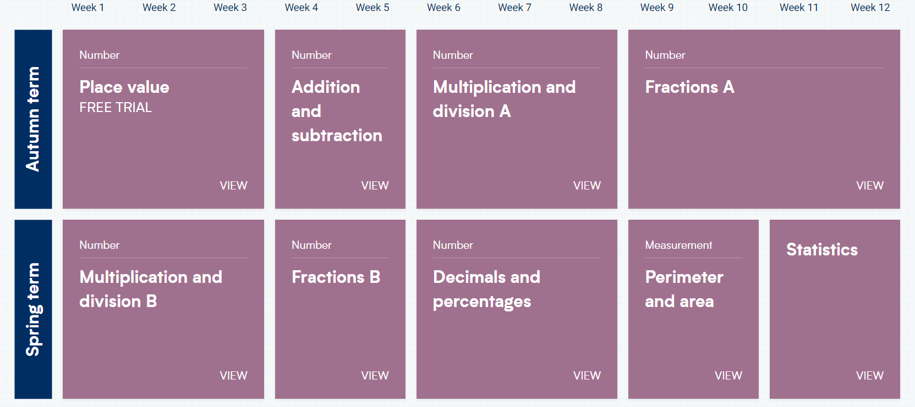
Our Curriculum Overview
Maths:

Slide 7




English

Slide 8
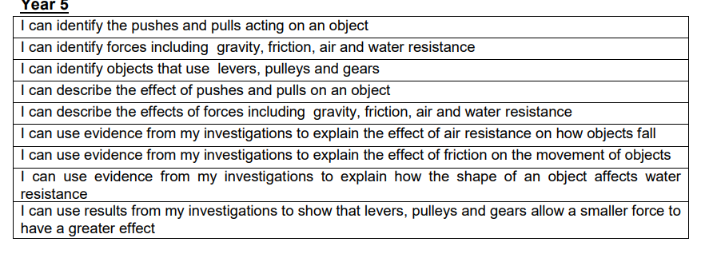
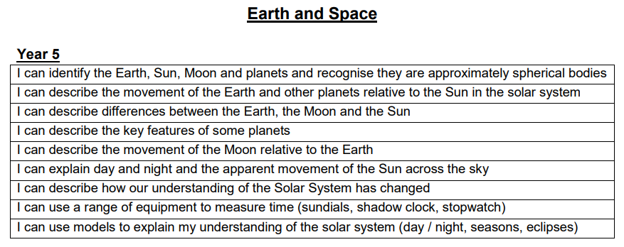
Science
Forces
Earth and space
History/Geography
History – Ancient Greece - 1st half term
Geography – The Americas – 2nd half term
Knowledge organise uploaded on TEAMs at beginning of topic.
RE
Come and See scheme, will have received Termly overview of topics. Judaism is the other faith studied.

Slide 9
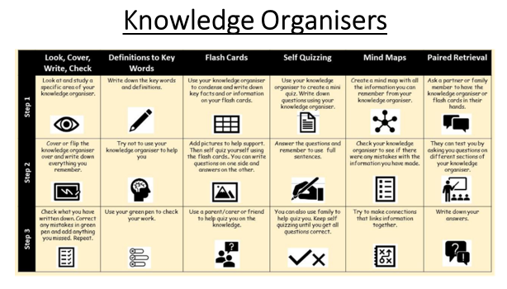
PE knowledge organiser

Slide 10
Homework
Given out Wednesday – due back Monday.
Regular practise of: spellings, times tables and reading.
Maths consolidation.
Writing, reading, research or arts.

Slide 11
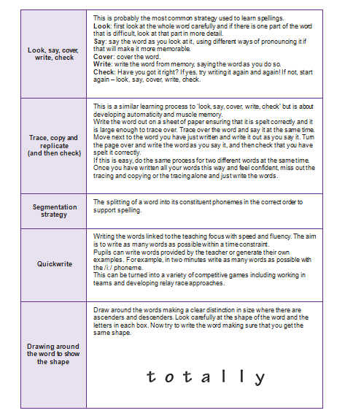
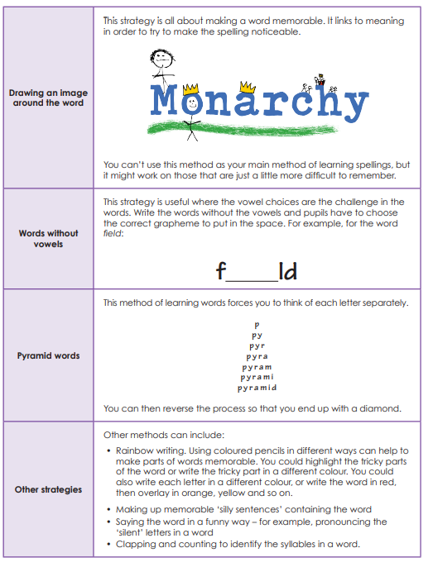
Spellings – No Nonsense Spellings

Slide 12
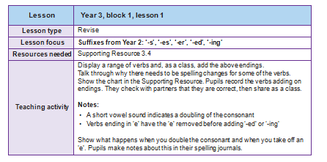

Slide 13
Reading
Exciting and engaging reading area - topic books
Reading in the classroom:
- Daily AR: 20 minutes
- Reading to an adult 1-1 or in groups
- Class novel 10 minutes
Reading at home daily – book reviews
STAR tests this week

Slide 14
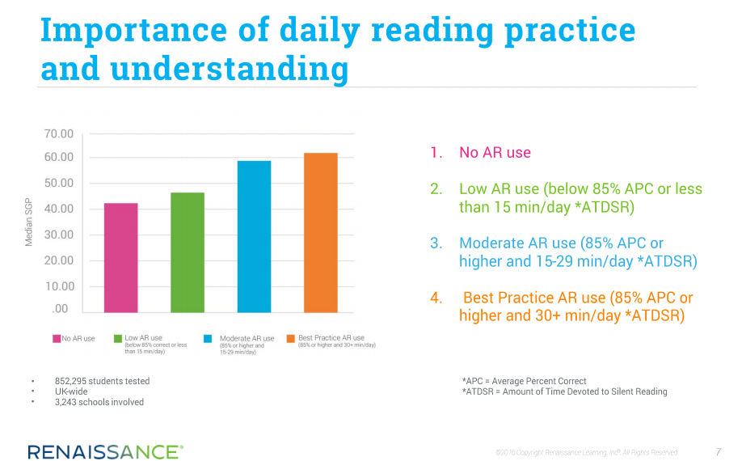
A Student Growth Percentile (SGP) offers a dynamic new way of looking at growth (progression) by comparing a student’s growth with that of his or her academic peers nationwide.
Reading – Accelerated Reader

Slide 15
Accelerated Reading: how it works
This first book is to practise the routine and learn the system.
Children are assessed 4 times a year using the Star Reading test (20 minutes), so their decimal range will change, along with their reading age and other data we can share with you at parents evening.
Children are given 1 decimal value to use for their first ever book selection ‘e.g. 3.2’. Once they have read and quizzed, showing super effort and 80% of questions correct, they will be given a decimal range to select books from ‘e.g. 3.2-4.6’.

Slide 16
Finding Books at Home
In Year 4, the book they borrow from us will stay in school.
We do not send reading books home.
Reading for enjoyment at home.
https://www.arbookfind.co.uk/

Slide 17
PE
P.E sessions take place on Wednesday and Thursday.
PE kits must be worn to school on the day of PE lesson
Trainers needed
Earrings need to be covered with own tape or taken off
Can purchase tracksuit at the office
No colourful gym leggings or trousers

Slide 18

STEM – Thursdays

Slide 19
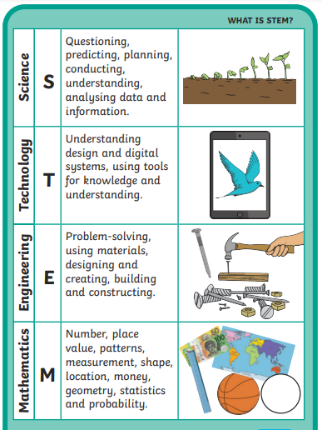

Slide 20
Medicine
Inhalers- named/in date
Allergies-medical form
Parental supervision for medicines such as antibiotics that need to be taken in school hours.
Please discuss with the school office if your child needs to take medicine/ apply medicated creams during school hours
Head injury – phone call
Head Lice – tie back long hair. Inform office.

Slide 21
Uniform
Plain waterproof/warm coat
No jewellery
Sensible watch
Green hairbands or bows
School shoes – no trainers please, only lace, Velcro or slip-ons
Names on every item!

Slide 22

What to bring to school everyday
Bag
Lunchbox (named)
Healthy snacks for playtime (labelled if in a tupperware box) – fruit, vegetables
We are a ‘no nuts’ school
Water bottle (named)
Pencil case to stay at school
Coat – either winter coat or
raincoat

Slide 23
Equipment
Glue stick
Coloured pencils
White board pen
We provide: pencil, whiteboard, whiteboard rubber, ruler, editing pen, and scissors.

Slide 24
Illness
No child should return to school until 48hours after vomiting
Your child should not be in school with an upset stomach for 48 hours.
Please inform the school office of your child’s absence (we will ring at 9:30 am if we haven’t heard from you)
If a child needs medication that has been prescribed by a doctor then a form needs to be completed.
Check your child’s asthma pump/epipen is up-to-date.
First aid officer – Mrs Coone

Slide 25
Welcome to Year 5!
Thank you for attending
If you ever need to contact me:
Email the office and they will forward onto me
Message on TEAMS (during school hours only)
Any questions?

