Slide 1

St Cecilia’s
2023-2024
Welcome to Year 1 and 2
at St. Peter’s

Slide 2

Staffing
Mrs Boyle: Mon, Tues, Weds
Mrs Ross: Thurs, Fri
Mrs Hall (every day except Tuesday)
Mrs Donohue, Miss Richardson, Mrs Maliangkay
Mrs Walker- Volunteer helper every Thursday morning.

Slide 3
Life in the Classroom
Positive learning environment where the children feel safe to take risks as learners
Disciple of the week, Star of the week, head teachers award, golden tickets, house points, stickers, class raffle
Trying our best, working together, supporting others
Good Learners Remember!
Growth Mindset- the power of YET
Reflection/time out
Faces used throughout all year groups

Slide 4

Catholic Ethos
Prayers to learn- we say or sing prayers in the morning, at lunchtime and at home time.
Mass – rota – dates for masses were included in the dates list- all welcome!
Encourage respect through rules, RE teaching and manners
Hymn practices
Learning about our class Saint
Inclusive school where we learn and celebrate all faiths

Slide 5
Collective Worship
Whole school assembly every Monday in the hall led by Miss McCluskey.
Class assemblies on Tuesday and Wednesday mornings.
KS1 assembly every Thursday.
Whole school celebration assembly every Friday afternoon.

Slide 6
Virtues
Tuesday assemblies cover different virtues and teach the children how we can behave through certain values.
Respect, honesty, hope, faith, trust, patience, love of learning, resilience, tolerance.

Slide 7
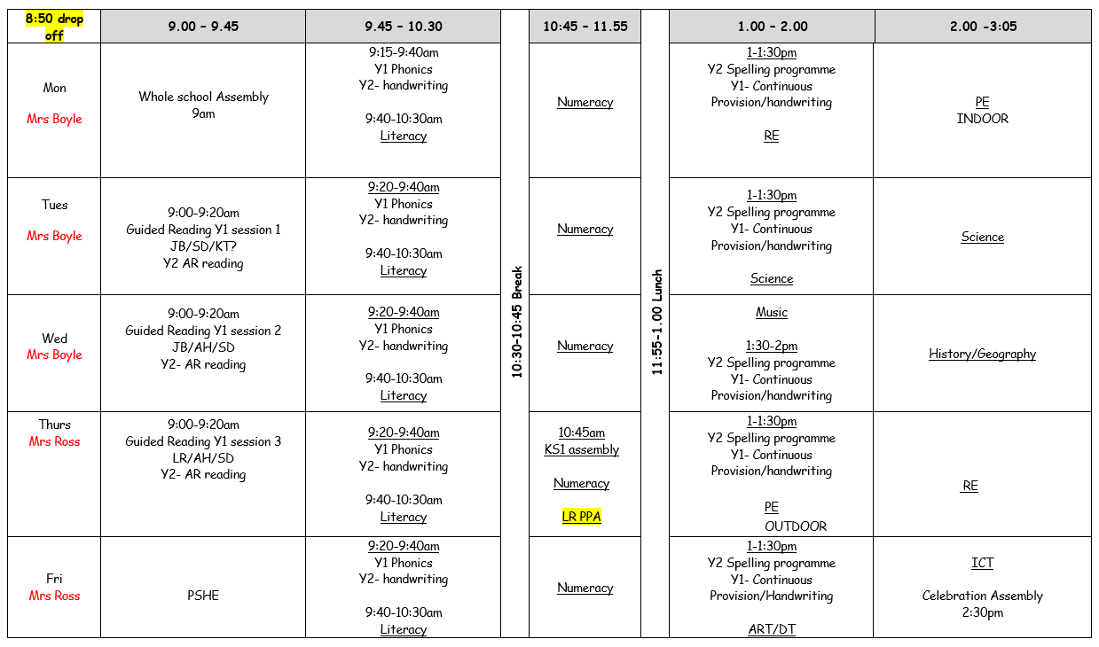
Our Weekly timetable

Slide 8
Daily: AR reading for Y2
English- SPag, Writing and Reading
Maths- Whiterose maths scheme
Handwriting/phonics/spelling using Little
Wandle Phonics programme
Phonics- daily for all children, keep up sessions and rapid catch-up session for children that need additional support.

Slide 9
Classroom Organisation
Mixed age group morning places.
Year 1 and 2 maths INPUTs taught separately. Maths places organised by ability. Adults moving round the room providing support/challenge where appropriate.
Phonics taught separately.
Literacy taught as whole class. Work differentiated appropriately.

Slide 10
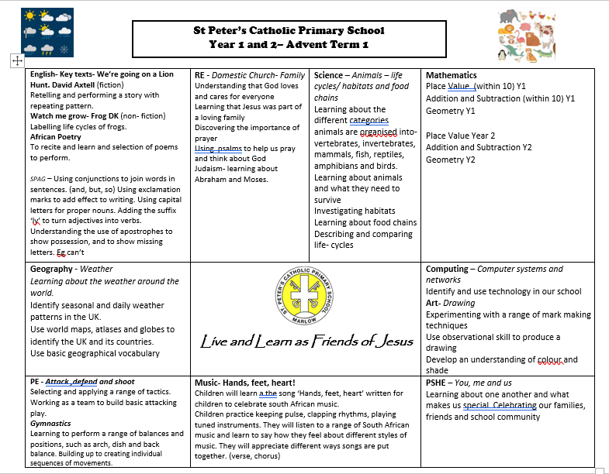
Parent Info sheet

Slide 11

Extract from curriculum overview…

Slide 12
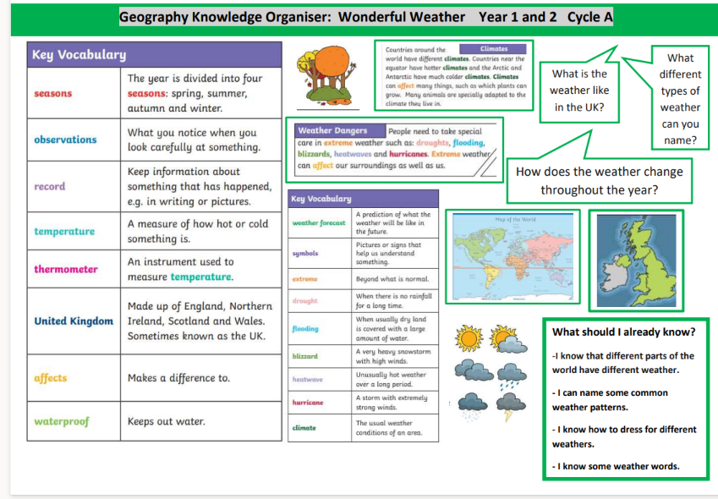

Slide 13
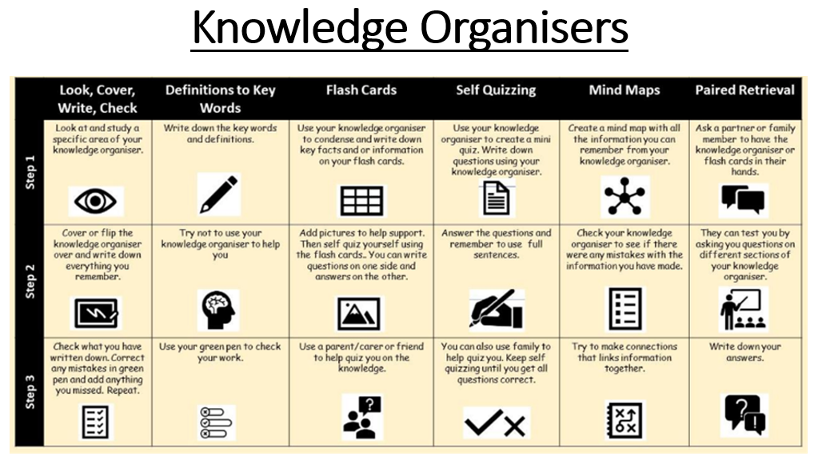

Slide 14
Homework
Homework will be sent home every Friday
Each week you child will have:
SPAG, English or topic based task OR Maths based on current class learning
Use of MYON Sign In - myON®
Reading/Timestable rockstars/Numbots- ongoing
Homework to be completed and handed in on the following Wednesday so that it can be marked before sending out new homework.

Slide 15
Reading
Exciting and engaging reading area- topic books
* Reading in the classroom:
- AR- for Y2 only
- Reading to an adult 1-1 or in groups
- Guided reading sessions for all year 1 and some year 2 children
Reading at home daily
Library book taken home/returned each Friday

Slide 16
To start…
Children are given 1 decimal value to use for their first ever book selection ‘e.g. 3.2’. Once they have read and quizzed, showing super effort and 80% of questions correct, they will be given a decimal range to select books from ‘e.g. 3.2-4.6’.
This first book is to practise the routine and learn the system.
Children are assessed 4 times a year using the Star Reading test (20 minutes), so their decimal range will change, along with their reading age and other data we can share with you at parents evening.

Slide 17
Finding Books at Home
https://www.arbookfind.co.uk/
Year 2 children can bring AR books home but must read again in school before quizzing.
Reading for enjoyment at home- library book.

Slide 18
PE
P.E sessions take place on Monday-Indoors and Thursday – Outdoors
PE Kits must be worn to school on the day of PE lesson
Trainers needed.
Earrings covered with own tape or removed if possible
No colourful gym leggings or trousers.
White socks please

Slide 19
Medicine
Inhalers- named/in date
Allergies-medical form
Parental supervision for medicines such as antibiotics that need to be taken in school hours. (Mrs Coone)
Please discuss with the school office if your child needs to take medicine/ apply medicated creams during school hours
Head injury – phone call
Head Lice – tie back long hair. Inform office.

Slide 20
Uniform
Plain waterproof/warm coat
No jewellery
Sensible watch
Green hairbands or bows
School shoes – no trainers please, only lace, Velcro or slip-ons.
Names on every item!

Slide 21
What to bring to school everyday
Bag
Lunchbox (named)
Healthy snacks for playtime (labelled if in a tupperware box) – fruit, vegetables
Water bottle (named)
Pencil case to stay at school
Coat – either winter coat or raincoat

Slide 22
Equipment
Pencil
Glue stick
Coloured pencils
White board pen
We provide – whiteboard, whiteboard rubber, ruler, scissors, felt tip pens

Slide 23
Birthdays
Please avoid sending in sweets for your child’s birthday (for healthy eating reasons)
-Healthy snack
Favourite book to share with the class?

Slide 24
Illness
No child should return to school until 48hours after vomiting
Your child should not be in school with an upset stomach for 48 hours.
Please inform the school office of your child’s absence (we will ring at 9:30 am if we haven’t heard from you)
If a child needs medication that has been prescribed by a doctor then a form needs to be completed.
Check your child’s asthma pump/epipen is up to date.
First aid officer – Mrs Coone

Slide 25
Spread the word…
Please spread the word about our wonderful and caring school to your friends and family.

Slide 26
Thank you for attending.
If you ever need to contact us:
Either message on TEAMS (during school hours only)
Or email the office and they will forward onto us.
Any questions?

