Slide 1
Year 3/4 2023-24
Welcome to St. Bernadette's at St. Peter’s

Slide 2
The School Day
Health
Life in Year 6
Curriculum
Homework
Communication
Catholic Ethos
How you can help
Staffing
Miss Paul: Monday-Friday
Mrs Coombs: TA Monday-Friday (AM)
Ms. Coone: TA Monday-Friday
1-1 specialist support Monday-Friday

Slide 3
Life in the Year 3/4 Classroom
We come into school at 8.45am prompt – learning begins straight away
The highest aspirations of all pupils – no glass ceiling
High standards of behaviour and academic work
Work hard, play hard
Growth Mindset and ‘learning behaviours’ **effort, curiosity and resilience**
Positive reinforcement (disciple of the week, star of the week, head teachers award, house points, golden tickets)

Slide 4
Illness
No child should return to school until 48 hours after vomiting or an upset stomach
Please inform the school office of your child’s absence (we will ring at 9:30 am if we haven’t heard from you)
If a child needs medication that has been prescribed by a doctor then a form needs to be completed.
Check your child’s asthma pump/epipen is up to date and that it is in school.

Slide 5
Medicine
Inhalers- named/in date
Allergies-medical form
Parental supervision for medicines such as antibiotics that need to be taken in school hours.
Head injury – phone call
Head Lice – tie back long hair. Inform Office.

Slide 6
Ensuring progression and confidence
Good Learners Remember
Short, sharp revision tasks – morning activities and lessons starters
Weekly written arithmetic
Maths – daily
SPaG – Daily in English lessons plus standalone lesson
Gap filling and SEN interventions all through the year
Homework tasks

Slide 7
Mixed-aged Math lessons
To ensure the children are taught at their step, the children are split into years groups for Maths.
Year 3s go into the year 3 classroom and complete their flashback 4 with Ms. Coone and Mrs. Coombes, while I do the flashback 4 with the year 4s and teach the lesson.
I then swap with the TAs and teach the year 3s their next lesson.
I alternate which days I start with year 3 and year 4 to ensure all children receive the same amount of input. This is working really well.

Slide 8
Homework Either weekly tasks and/or project based…
This will be set on Teams on a Friday
Access work and complete in books. (Do not upload)
Some tasks will be completed on paper
Bring books in on Wednesday for discussion and marking.
No need to print questions, write answers directly in book.
Eco school so trying to reduce paper used
Maths (arithmetic, problem solving), English (SPAG, spellings, comprehension, reading), plus topic based activity
A little and often – organise your time

Slide 9
Homework Either weekly tasks and/or project based…
Please help your child to ensure their homework is:
On time – homework is not optional
Unless specified, takes no more than ½ hour per night.
If your child is taking longer than this on a regular basis or having problems with homework, please let us know.
We will inform you if homework is regularly missing or below expectation.
Spelling test – Weekly, Friday morning
Times tables – practice (Rockstars), cracking times tables

Slide 10
TEAMS/School Rep
Homework is set on Teams – there will be separate tasks for year 3 and 4.
TEAMS used to quickly send out reminders via posts.
Please discourage children sending messages and clogging up post boards.
Class Rep will also sometimes be used to relay information -Thank you!
Please check Teams regularly.

Slide 11
A Student Growth Percentile (SGP) offers a dynamic new way of looking at growth (progression) by comparing a student’s growth with that of his or her academic peers nationwide.
Reading – Accelerated Reader

Slide 12
Reading – Accelerated Reader
https://global-zone61.renaissance-go.com/welcomeportal

Slide 13
To start…
Children are given 1 decimal value to use for their first ever book selection ‘e.g. 3.2’. Once they have read and quizzed, showing super effort and 80% of questions correct, they will be given a decimal range to select books from ‘e.g. 3.2-4.6’.
This first book is to practise the routine and learn the system.
Children are assessed 4 times a year using the Star Reading test (20 minutes), so their decimal range will change, along with their reading age and other data we can share with you at parents evening.

Slide 14
Finding Books at Home/MyON
The book they borrow from us will stay in school.
Your children will have their ZPD (decimal number) and can go onto the Book Finder website to find appropriate texts
myON offers unlimited access to an enhanced digital library - used for homework and research
https://www.arbookfind.co.uk/
Please encourage your children to read within their decimal range at home and spread the joy of reading and books.

Slide 15
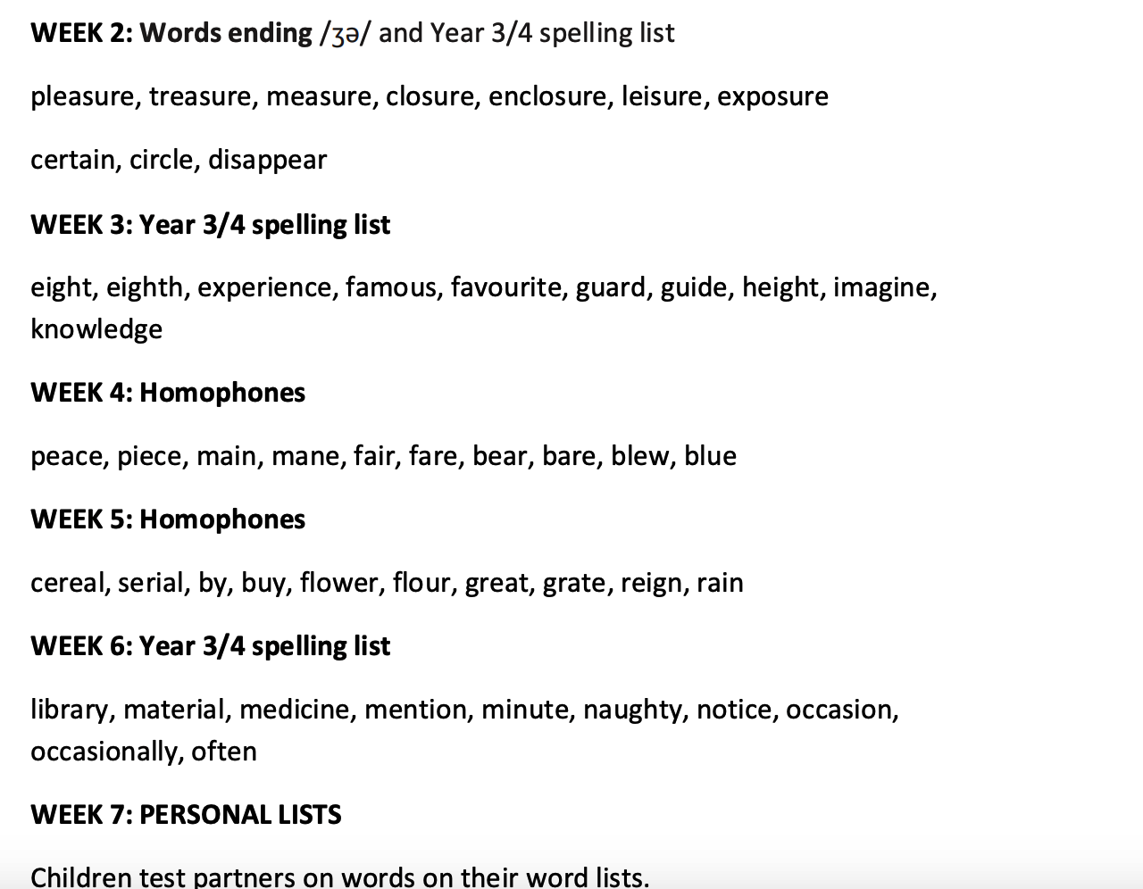
Spellings – No Nonsense Spellings

Slide 16
PE
P.E sessions take place on Tuesday (Football) and Thursday (Gymnastics)
PE Kits must be worn, children will not take part if they do not have the right clothing or footwear. Earrings out

Slide 17
Uniform
Plain waterproof/warm coat
No jewellery
Sensible watch (test conditions – no bleeping)
School shoes (not boots) –(trainers on PE days) lace, Velcro
Names on items

Slide 18
Letters to return
Home/school agreement
Addresses
Phone numbers
Medical information
Consent – photos (for new starters)
General consent for local visits
Take home, sign/fill in and return to school next week

Slide 19
Catholic Ethos
Prayers to learn
Assemblies - Class Assembly Monday 27th November
Mass – in school and at church
Class assembly
Encourage respect through rules,
RE teaching and expectations

Slide 20
What we would be grateful for…
Tissues
Copies of class novel
Check equipment – we will provide a handwriting pen, pencil, ruler, scissors, rubbers and sharpeners
Please provide board pens, colouring pencils and a glue stick.

Slide 21
Friends of St. Peters, Marlow
A warm welcome to all
Who are we?
What do we do?
How can you help?
Friends of St. Peters, the school's PTA and a charity. Charity No. 273398
All Parents, Teachers and Friends of the School are welcome.
We have a Chair, Secretary and Treasurer, who are voted in each year.
Working alongside the school to run fundraising events throughout the year.
Our events are varied, we've run School discos, Bake Sales, balls. Last year we added Fruity Fridays, Breaking The Rules Day, but we are always looking for more ideas.
All of which goes towards the benefit of the school and our children.
We understand it's going to be a tough year ahead for everyone, so we need to think of new inventive ways to fundraise.
Please help with suggestions, joining our meetings and where possible volunteer to help.

Slide 22
Verulamium Museum Trip
16th October 2023
£4 – per child
Letter coming out this half term with all the details.
https://www.youtube.com/watch?v=hiuMBPKrQlQ

Slide 23
Spread the word…
Please spread the word about our wonderful and caring school to your friends and family.

Slide 24
Welcome to Year 3/4!
Thank you for attending.
Any questions?

