Slide 1

Reception Welcome Meeting
October 2023

Slide 2
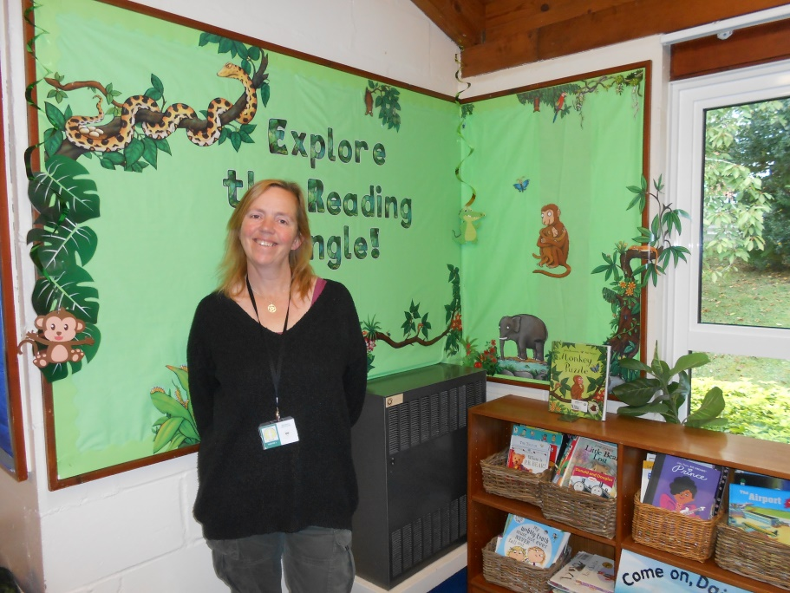
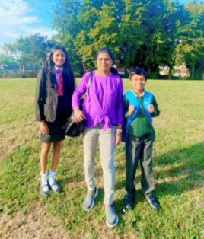
Meet the Team!
Mrs Gerrard
Class Teacher
Every day except Tuesday afternoon.
Mrs Sreenath
Teaching Assistant.
Every day.

Slide 3
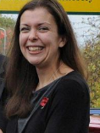
Mrs Thomas
Deputy Head Teacher
PPA cover Tuesday afternoons.

Slide 4
EYFS Curriculum
• The EYFS Profile (Curriculum) changed in September 2021. The main changes are: New early learning goals (ELGS) and different descriptors for how and when children should be attaining throughout the Early Years stages.
• There are 7 areas of learning, 3 prime (maths, literacy and expressive arts and design) and 4 specific (communication and language, personal, social and emotional development, physical development and understanding the world).

Slide 5
• Children will be assessed as to whether they have met the 17 early learning goals in the summer term.
• Children should also demonstrate the ‘characteristics of effective learning’ during their free choice time.
This is: playing and exploring - children investigate and experience things, and ‘have a go’ active learning - children concentrate and keep on trying if they encounter difficulties, and enjoy achievements. There are prizes for completing the challenge rainbow every week! creating and thinking critically - children have and develop their own ideas, make links between ideas, and develop strategies for doing things’
It’s not just playing!
• Each week children will have set phonics, literacy, maths, RE, PE and computing times.
• All will be based around the current topic.
• Children are observed choosing and this is recorded and put in their learning journals.
• A statutory baseline is recorded in the first half term.

Slide 6
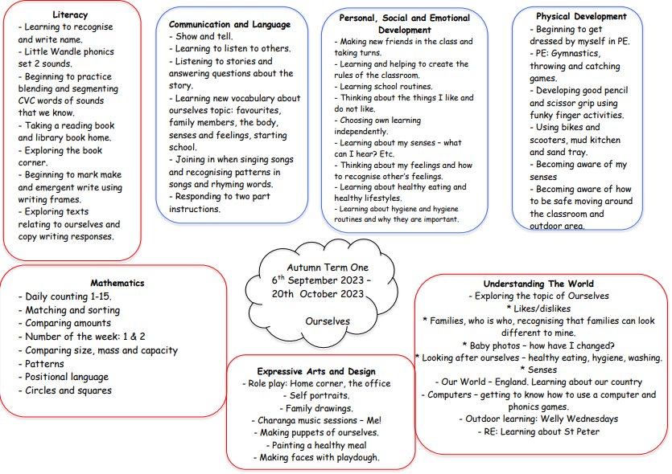
Our current topic

Slide 7
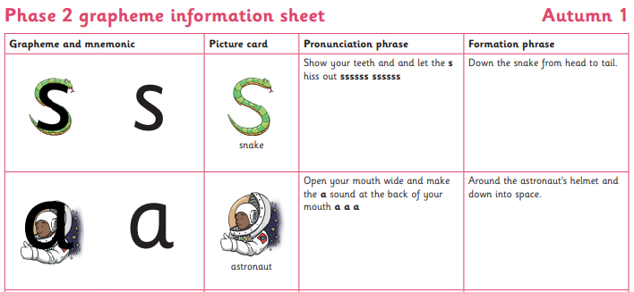
We use the little Wandle Phonics scheme. For parent information go to: https://www.littlewandlelettersandsounds.org.uk/resources/for-parents/
Phonics
• Phonics is the learning of letter sounds to
support reading and writing.
• Children will develop their phonemic
awareness by learning to hear, identify and
manipulate sounds. This will then help them
with their reading and writing.

Slide 8
Phonics
Key Words
• Phoneme: smallest unit of sound in a word.
• Grapheme: the sound written down.
• Diagraph: when two letters make a phoneme/sounds.
• Split diagraph: when a diagraph is in a word, but are
not together, for example cake.
• Blend: putting sounds together to make words, for
example c-a-t
• Segment: splitting sounds in a word – this can help
with spelling.
• CVC words: consonant vowel consonant words. Simple
words that the children will begin to read. For
example, s-a-t. Later on in the year we move to CCVC
and CVCC words.

Slide 9
How do we teach phonics?
• Phonics is taught daily.
• Children will learn around 5 new sounds a
week.
• Children are encouraged to use phonics all the
time by the adults around them modelling.
• Children will learn Phases 2 – 4 in Reception and Phase 5 in year one.
• At the end of year one children will have a
phonics check.

Slide 10
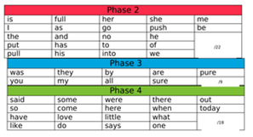
Phonics
Tricky words
- They are words that children won’t be able to blend and segment to read and write.
- Children should be able to recognise and read these words from memory.
- Words will go home to practice when they have learned all set 2 sounds.

Slide 11

Helping At Home
• Reading books and phonics flash cards/tricky words.
• Sounding out simple words as you are sayingthem.
• Pointing out words that begin with/have the new sound in them (these will be on the bottom of the weekly news).
• Using sounds rather than alphabet.

Slide 12
Other ways to help
Try some reading/phonics games:
* Phonics play website
* Phonics bloom website
* Youtube: Jolly Phonics, Mr Brock phonics,
letters and sounds videos.
* Alphablocks
* Teach Your Monster to Read website

Slide 13
Reading
• Children will be provided with a reading folder, reading record
and phonics fans.
• Children will get a new reading book on a Friday. They will have been reading this at school the previous week and should be confident to read it at home. Repetition is important for retaining words, which is what helps us to become fluent readers!
* The children will read in small groups twice a week and individually at least once a week.
• Please ensure that reading folders come to school everyday, and
are placed in the box which will be on the table near the
pegs. This way we can ensure that we can read whenever an opportunity presents itself!
• Each week they will take home a new library book, to be changed on a Friday.
Please bring back library books on a Friday as a new one can’t be sent home until the last one has been returned.
* Remember to read for pleasure, children learn what a good reader is from us!
Should you ever have any questions about supporting your child’s
reading or phonics please let us know.

Slide 14
You can access parent information about White Rose maths on https://whiteroseeducation.com/parent-pupil-resources/maths
Maths
• We follow the White Rose maths scheme of learning at St. Peter’s.
• This teaching style focusses on the small steps of mathematics, so we learn concepts more slowly but go deeper to allow a great depth of knowledge for mathematics.
Each unit allows children to fully understand each step before moving on to the next.
There is a focus on the use of different representations of number, 10 frames, number tracks and using counters.

Slide 15
Behaviour
• Our school behaviour policy revolves
around our school rules, ‘faces’ and
reflection.
• Children have 3 chances before given an
age appropriate consequence this may
be time out from choosing or missing
some lunch time or break time play.

Slide 16
Reminders
• Any medication should be up to date (eg. Inhalers) and can
only be administered by trained staff.
• We will always call you for a head bump!
• Please bring any trip or occasion money in a named envelope.
• Ensure all school uniform is neat, tidy
and named. Children should be wearing ties if they are
wearing a shirt or blouse. Long hair should be tied back. We
will try our best to keep your child’s uniform as clean as
possible but sometimes muddy clothes can mean great
learning!
• Children will need a bag big enough for an A4 folder.
* All snacks should be healthy ones, preferably fresh fruit. No nuts please as there may be serious allergies in school.
• PE kits in school every day. They will be sent home every half term/end of term unless they are particularly mucky!
• Toys: please leave them at home ☺

Slide 17
Contact
Please log in to our Teams page to read the Friday News. This will include information about what has happened during the week, and also any important news for the coming week.
You can message me in the posts area, or talk to us in the morning if you have concerns. If you would like a longer meeting please make an appointment for after school.

Slide 18
We are looking forward to a great year!
Do you have any questions?

