Slide 1
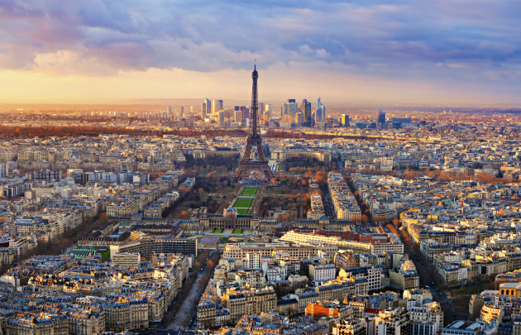

Bonjour today I am flying to this destination, this one is not hard, you can see I am using one of the paper rug that year 5 will be doing!

Slide 2

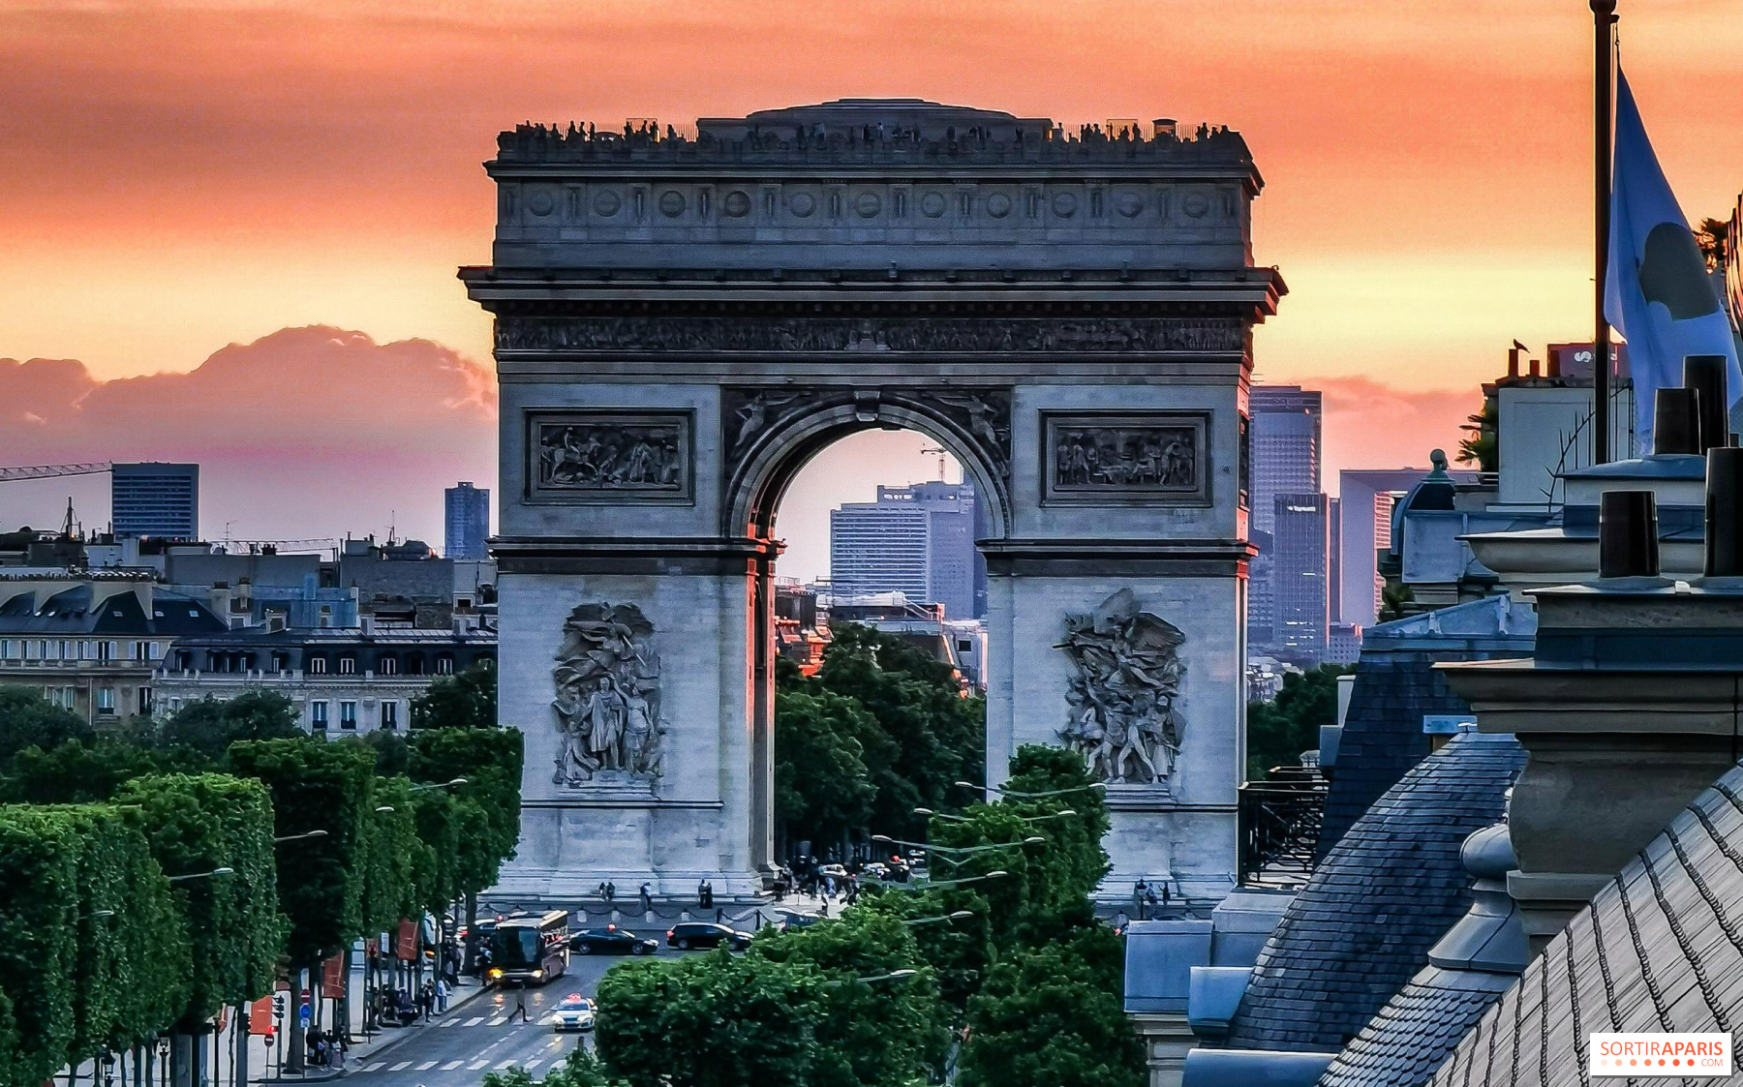
1 What is this monument called in French?

Slide 3
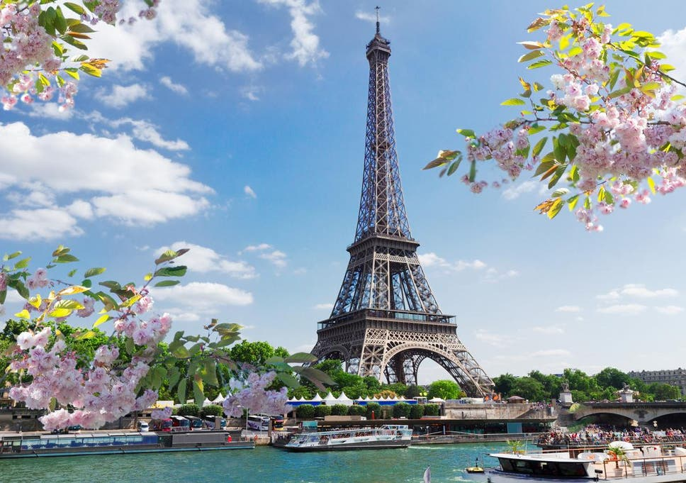
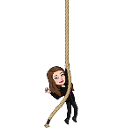
2. What is the name of the monument in French?

Slide 4
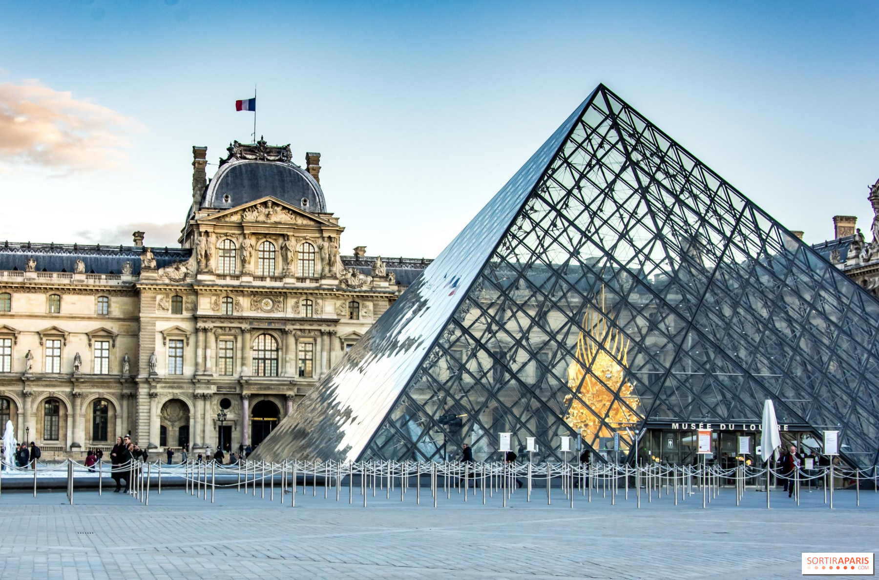

3. What is the name of the monument in French? It has one of the most famous painting in the world

Slide 5
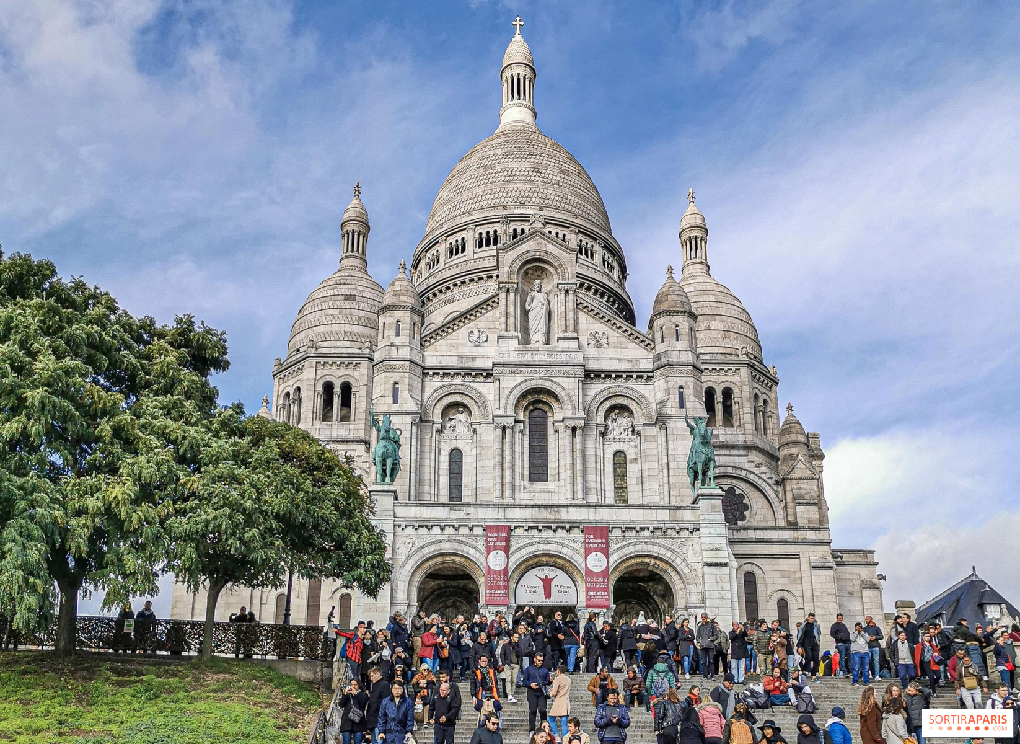

4. Comment s’appelle le monument en francais? It is situated in Montmartre and you can see the whole of the city

Slide 6
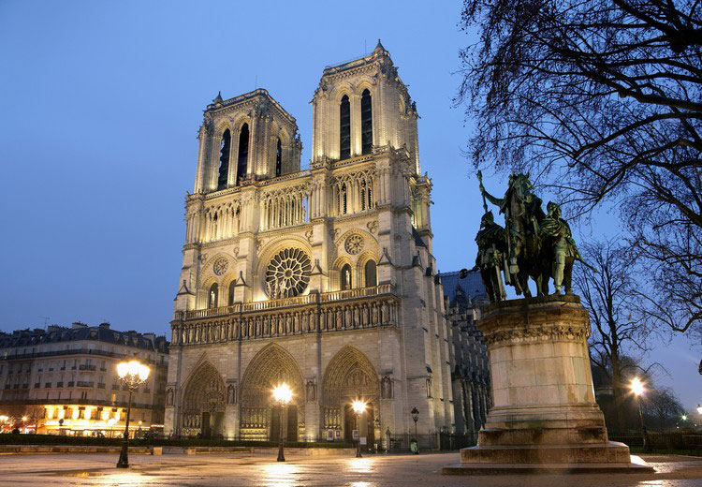
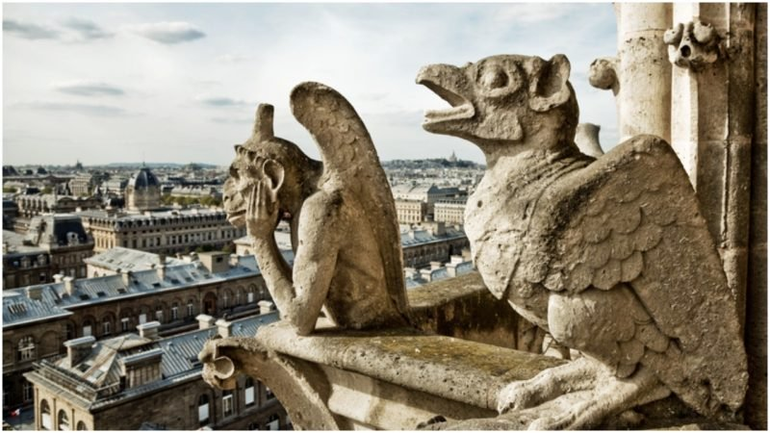

5. Comment s’appelle le monument en francais? The gargoyles are guarding this impressive cathedral

Slide 7
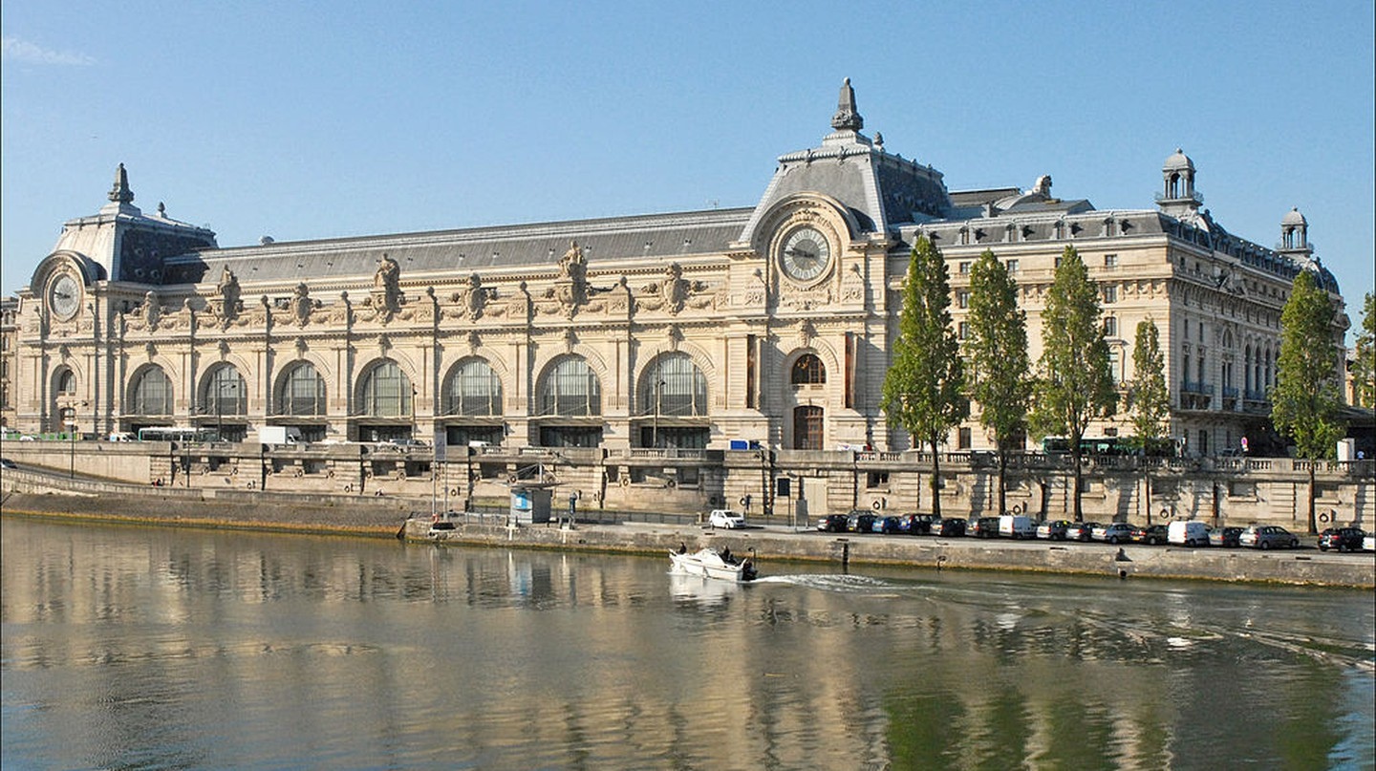

6. Comment s’appelle le monument en francais? It is a Beaux-Arts railway station built between 1898 and 1900
Notes:
Musee d’orsay

Slide 8
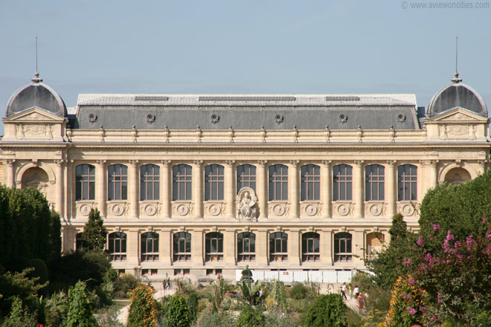

7. Comment s’appelle le monument en francais? It contains many extinct species

Slide 9
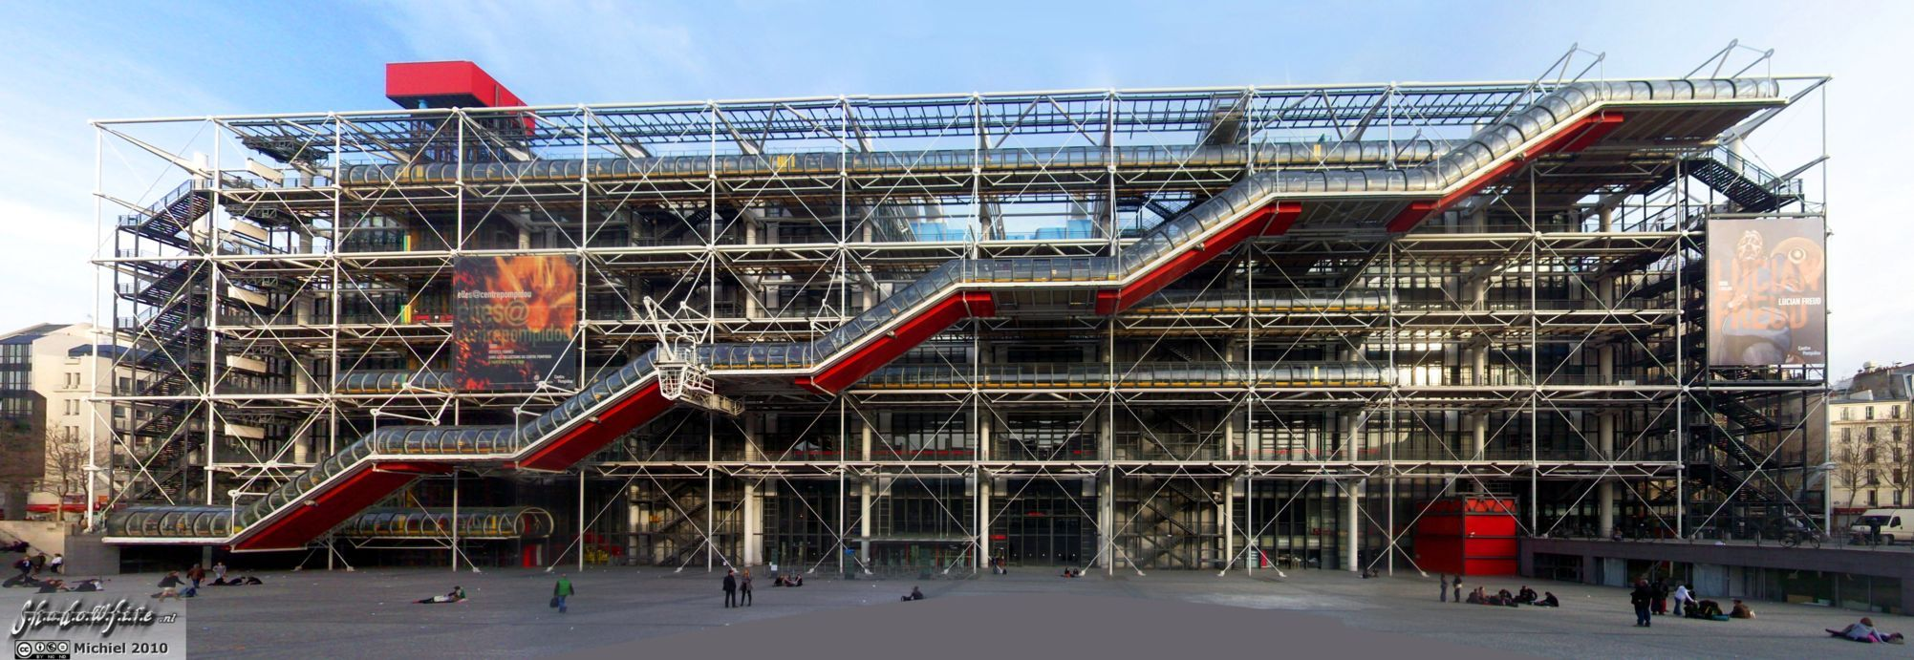

8. What is the name of the monument in French?This is a cultural centre

Slide 10
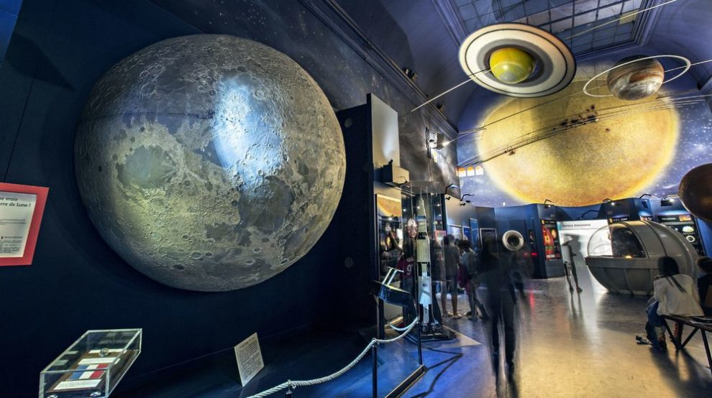
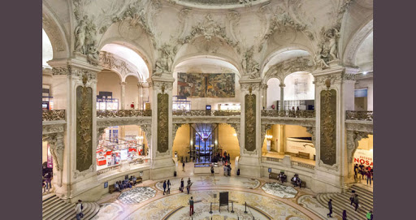

9. What is the name of the monument in French?It is a science museum

Slide 11
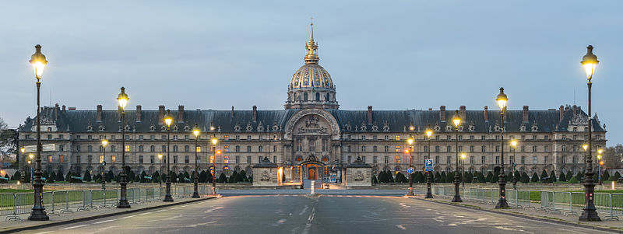

2. Comment s’appelle le monumnt en francais? It is a museum army

Slide 12
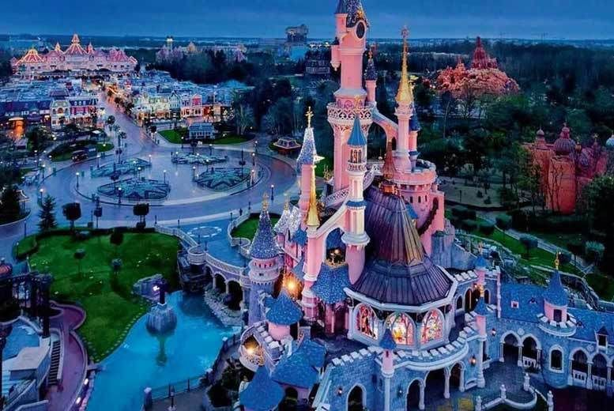

I am more in my element of magic now!

Slide 13
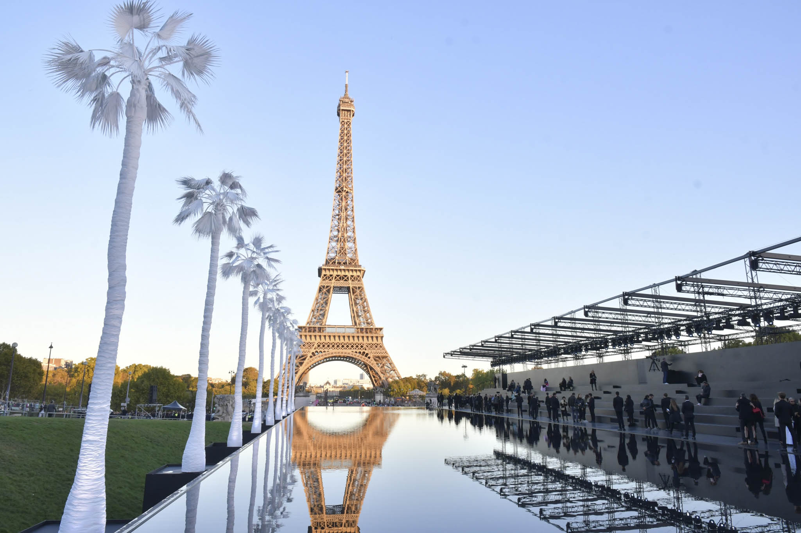


So now tell me about la ville I am flying to this week and answer the
question by replying in the eschool message.On every slide there is a mini-me hiding. Can you see me? Ou est Mme Alani?

