Slide 1
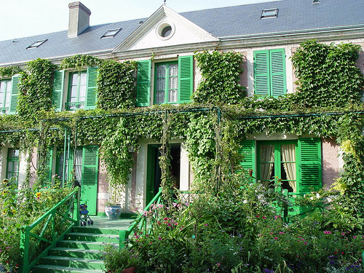
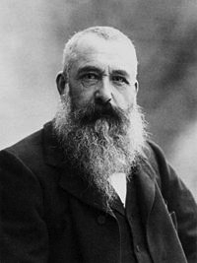
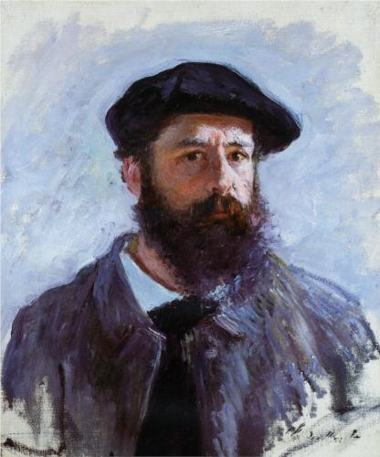

La maison de Monet
Lesson objective: to recap rooms in the house & to learn about the famous French artist Monet

Slide 2
La maison de Monet
Claude Monet, in full Oscar-Claude Monet, (born November 14, 1840, Paris, France—died December 5, 1926, Giverny), French painter who was the initiator, leader, and unswerving advocate of the Impressionist style.
At his home in Giverny, Monet created the water-lily pond that served as inspiration for his last series of paintings. His popularity soared in the second half of the 20th century, when his works travelled the world in museum exhibitions that attracted record-breaking crowds and marketed popular commercial items featuring imagery from his art.

Slide 3
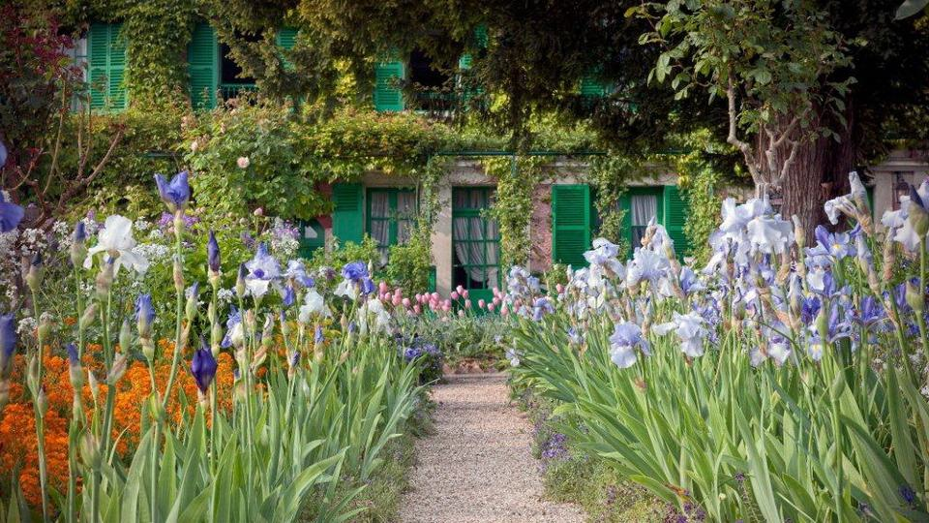
la maison de Claude Monet à Giverny

Slide 4
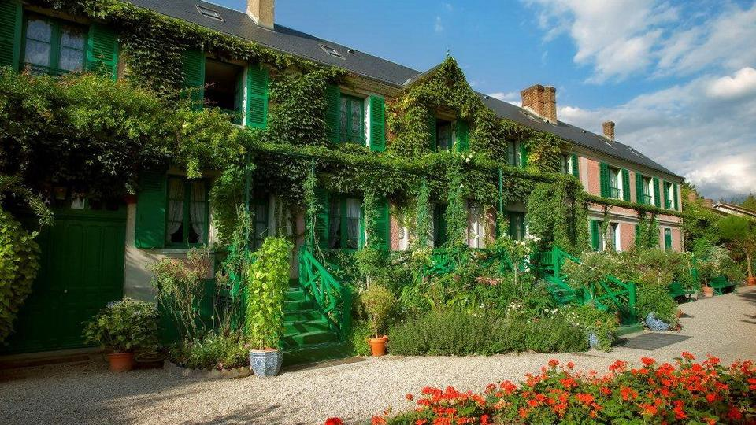
la maison

Slide 5
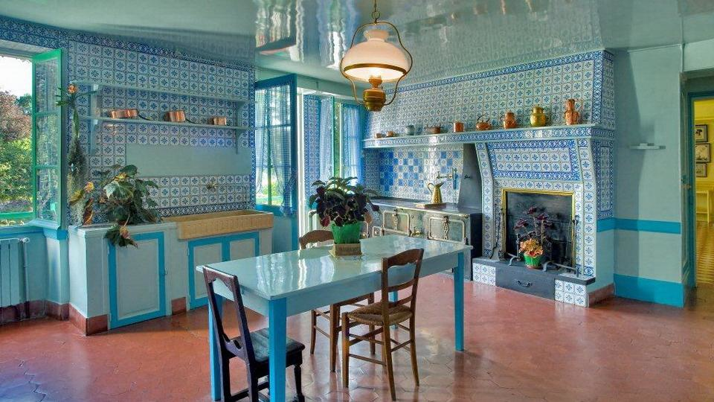
la cuisine

Slide 6
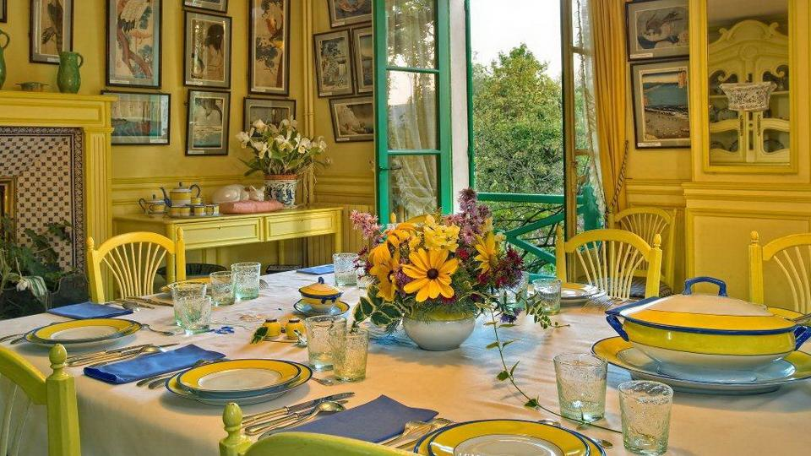
la salle à manger

Slide 7
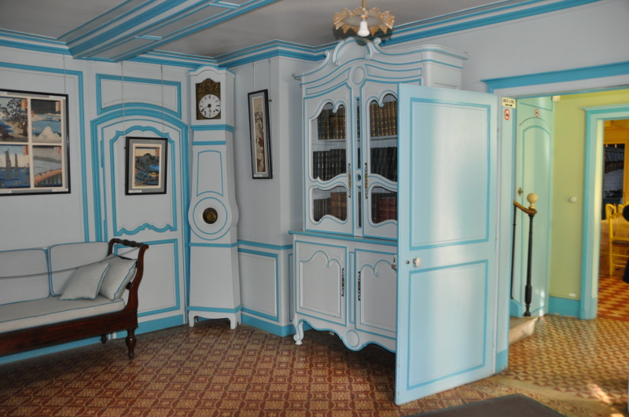
le salon

Slide 8
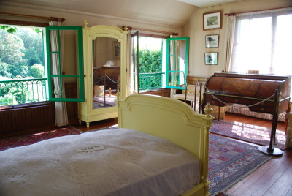
la chambre de Claude Monet

Slide 9
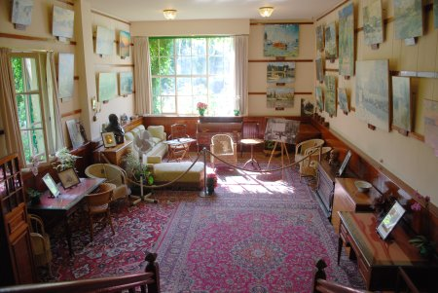
le bureau (l’atelier) de Monet

Slide 10
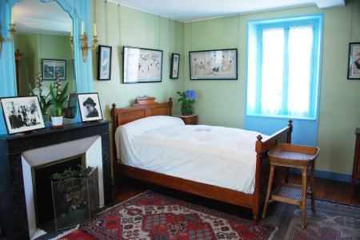
la chambre d’Alice

Slide 11
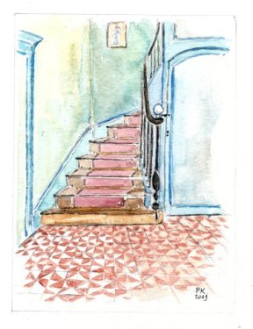
les escaliers

Slide 12
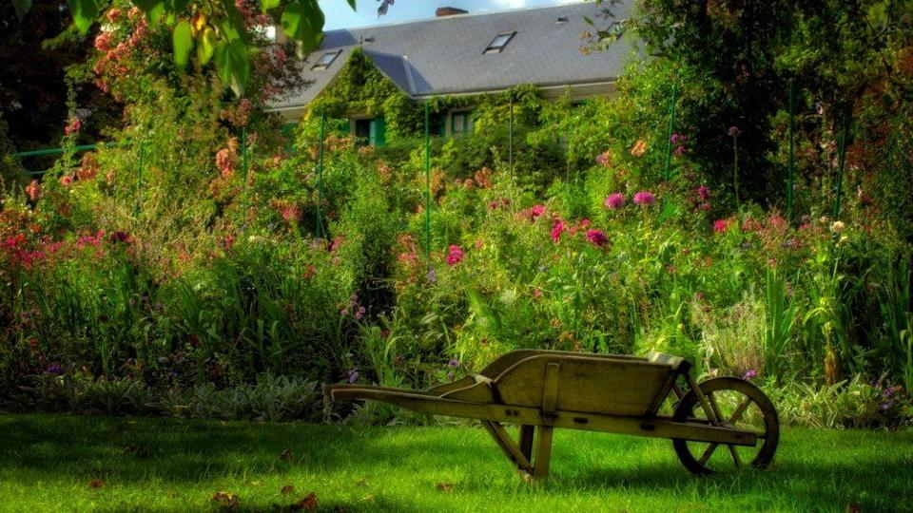
le jardin

Slide 13

l’étang avec son pont

Slide 14
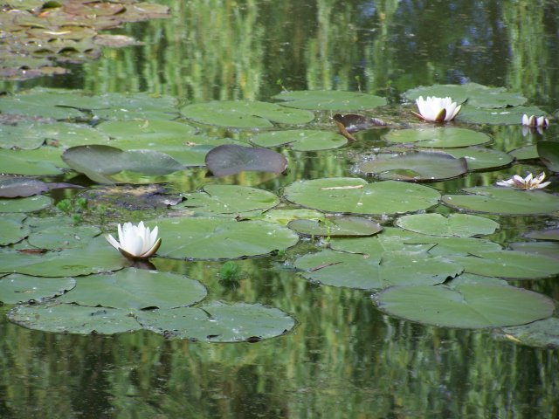
les nénuphars

Slide 15
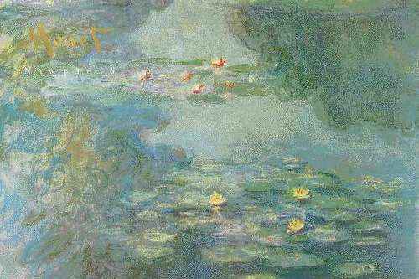
les nymphéas

Slide 16
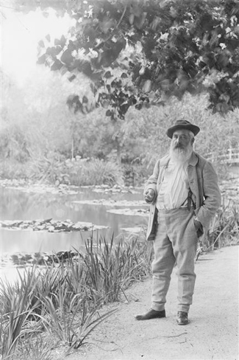
Monet dans son jardin

Slide 17
La maison de Monet
How much can you remember?

Slide 18
La maison de Monet
Claude Monet, in full Oscar-Claude Monet, (born November 14, 1840, P*r*s, France—died December 5, 1926, Giverny), French painter who was the initiator, leader, and unswerving advocate of the *mpr*ss**n*st style.
At his home in G*v*rny, Monet created the water-lily pond that served as inspiration for his last series of paintings. His popularity soared in the second half of the 20th century, when his works travelled the world in museum exhibitions that attracted record-breaking crowds and marketed popular commercial items featuring imagery from his art.

Slide 19
l* m**s*n de Claude Monet à G*v*rny

Slide 20
l* m**s*n

Slide 21
l* c**s*n*

Slide 22
l* s*ll* à m*ng*r

Slide 23
l* s*l*n

Slide 24
l* ch*mbr* de Cl**de* M*n*t

Slide 25
l* b*r*** (l’atelier) de Monet

Slide 26
l* ch*mbr* d’Alice

Slide 27
l*s *sc*l**rs

Slide 28
l* j*rd*n

Slide 29
l’*tang avec s*n p*nt

Slide 30
l*s n*n*ph*rs

Slide 31
l*s nymph**s

Slide 32
M*n*t dans son j*rd*n

Slide 33
FOLLOW ON WORK:
Who was Monet?
Where in France is Giverny?
Which rooms in the house did you recognize?
(List them in French and English)
Which rooms were missing?
(List them in French and English)
What do you think of his house? Can you give an opinion word in French?
e.g. belle – beautiful, moche – ugly, grande – big,
petite – small, pittoresque – picturesque

Slide 34
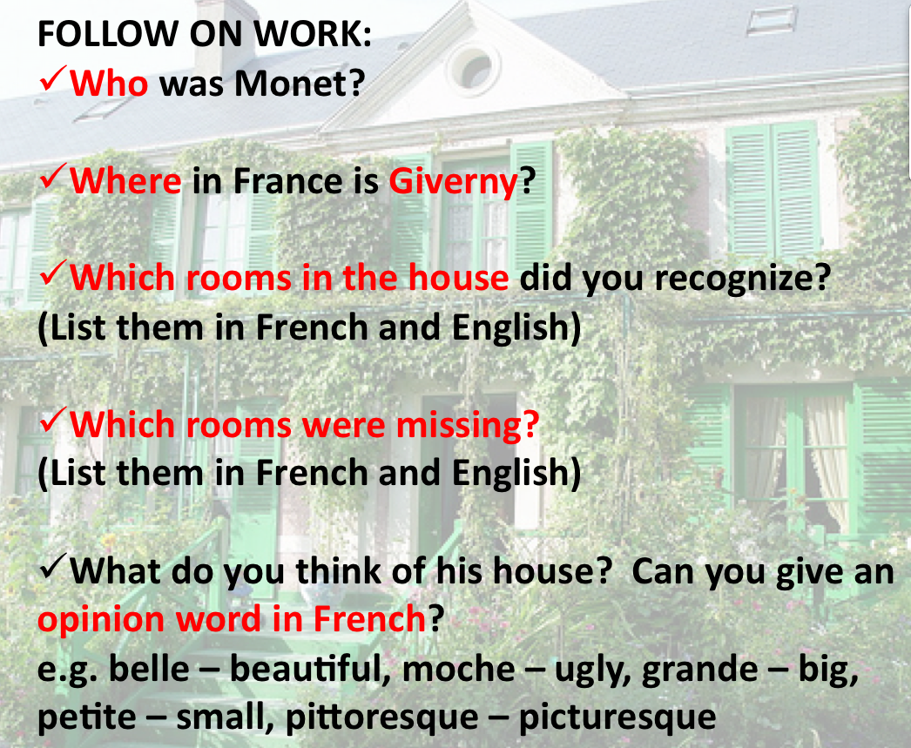
My answers
Type your answers into the box below:

Slide 35
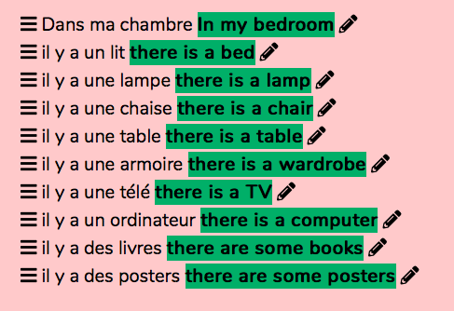
Language Learning Games
https://www.educandy.com/site/resource.php?activity-code=1352c
Click on this link and have a go at the games which will help you to recap some of
the useful furniture vocab we looked at at the end of last term.
PREP:
Learn your rooms
in the house and
these 10
expressions in French
for a test next
Monday

Slide 36
Youtube links
If you want to listen to the Berthe Story again,
click here: https://safeYouTube.net/w/FGP8
If you want to hear the song again, click here:
https://safeYouTube.net/w/mHP8

