Slide 1
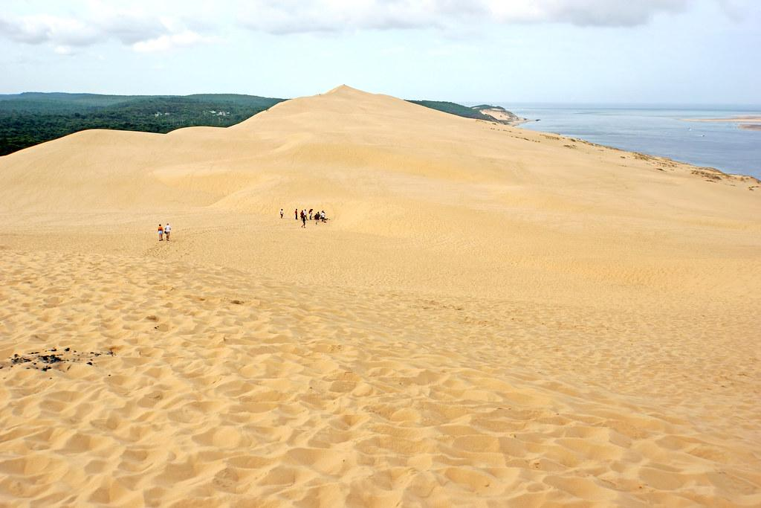


Aujourd’hui(today) I am working on a dune and no I am not in the sahara

Slide 2
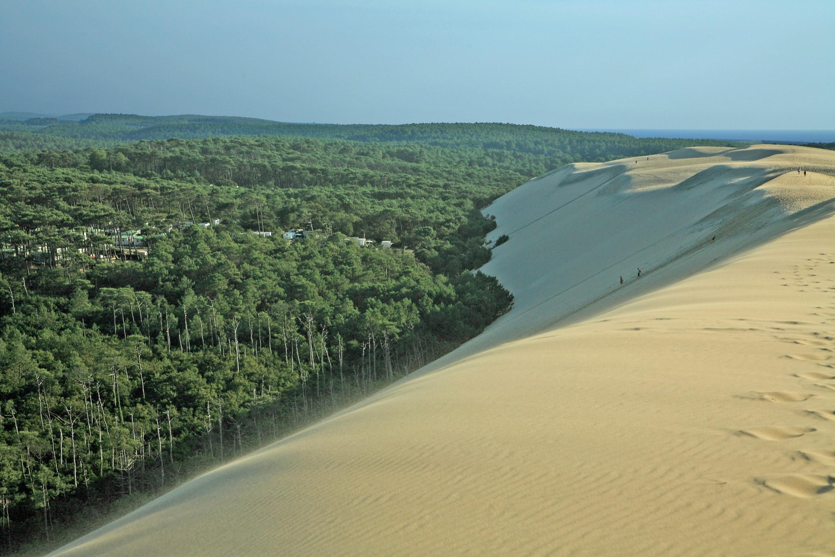

a massive sandy dune and the sea on one side, and a forest on the other, this is a sight that you have to see to believe.

Slide 3
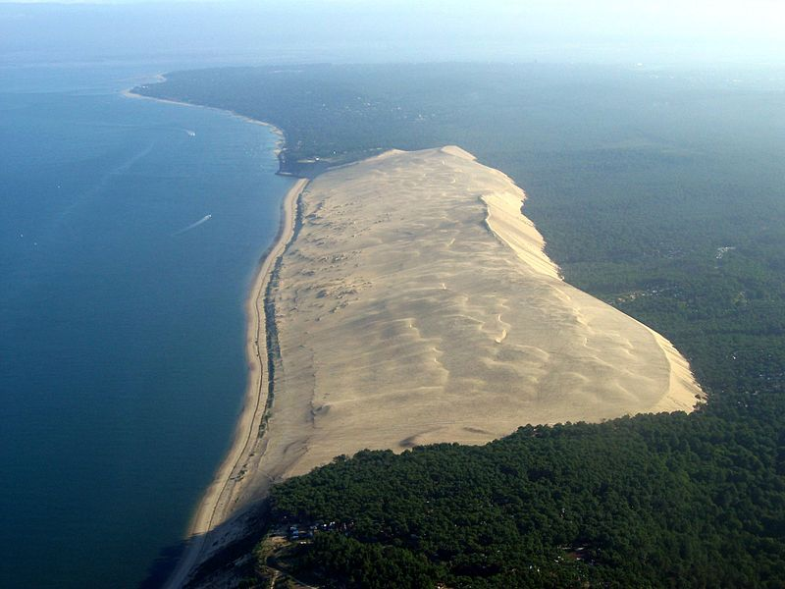

Slide 4
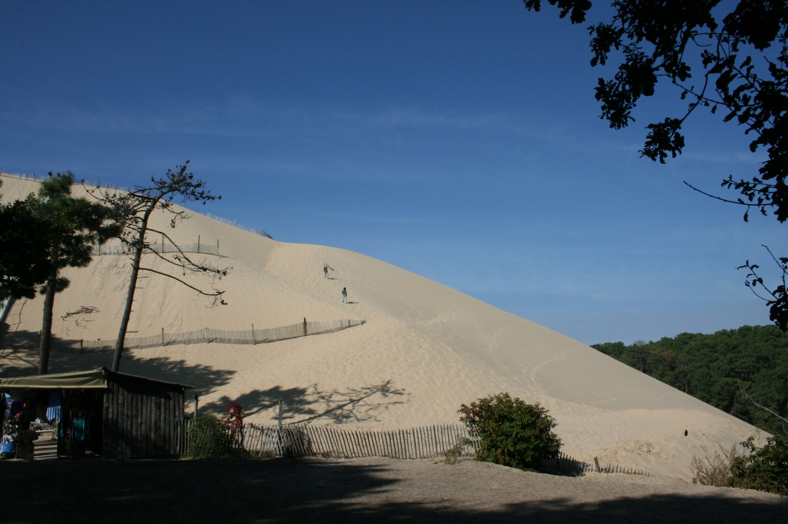

It is located in La Teste-de-Buche a lot of people come to paraglide

Slide 5
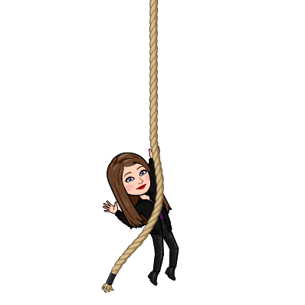
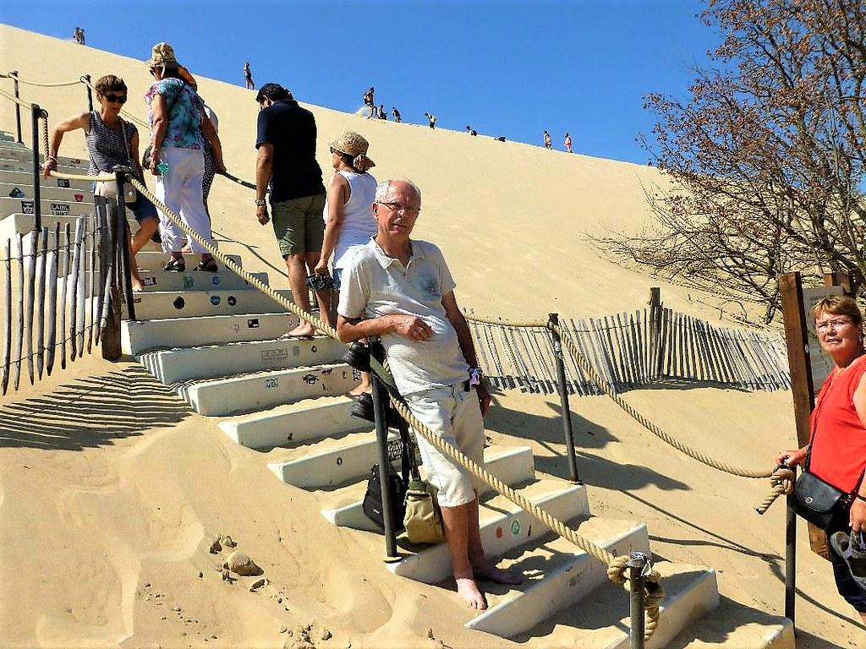
There are stairs to help you climb the dune. On top you will be able to see both the sea and the forest from each sides

