Slide 1
Year 5 Welcome Meeting
Thursday 17th September 2020

Slide 2
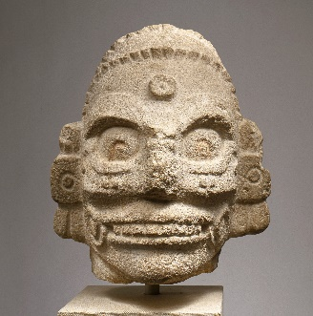
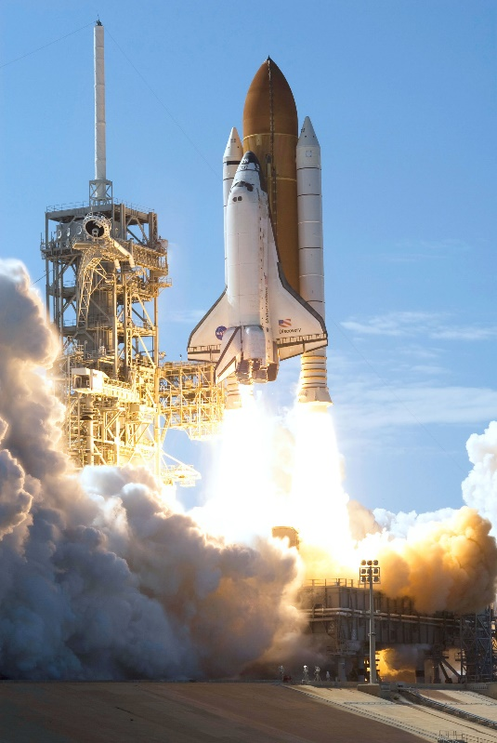
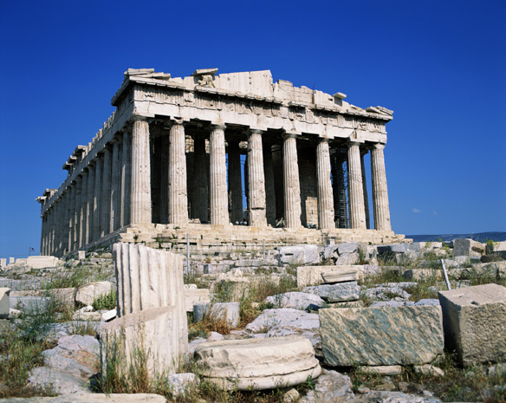
Year 5 2020
Building onto prior learning and skills.
‘Work hard, play hard.’
Positive year where positive behaviour will be praised.
Golden tickets
House points
Verbal positive reinforcement
Safe and inclusive.
Wide and varied curriculum.

Slide 3
Trips, visits and learning enrichment.
Monday 14th September – letter went out to ask for a contribution to cooking/art/topic enrichment activities. Thank you if you’ve contributed so far.
Keep trying to organise a trip or visit at the soonest possible and safest opportunity.

Slide 4
Transfer test. https://www.buckscc.gov.uk/services/education/school-admissions/grammar-schools-and-secondary-transfer-testing-2021-entry/secondary-transfer-testing-2021-introduction/
We do not teach inline with this examination.
Autumn 2021 test date – automatic opt in. To opt out next year, write a letter to Miss McCluskey stating so. You don’t need to do this until next scholastic year (Year 6).
We can discuss your thoughts and queries at the end of the summer term if you feel you need our advice for opting out.

Slide 5
Covid -19
The main symptoms of coronavirus (COVID-19) are:
a high temperature – this means you feel hot to touch on your chest or back (you do not need to measure your temperature)
a new, continuous cough – this means coughing a lot for more than an hour, or 3 or more coughing episodes in 24 hours (if you usually have a cough, it may be worse than usual)
a loss or change to your sense of smell or taste – this means you've noticed you cannot smell or taste anything, or things smell or taste different to normal
Do not send your child into school with any of the above and get them tested. Inform the school immediately test results received.
If in doubt don’t send them in

Slide 6
COVID-19 cont.
If there is a confirmed case Thames Valley Authority will take the lead
Staggered start
Please don’t come before your child’s class start time (8.45)
If you have children in more than 1 year group there is a waiting zone in the playground
If you are early please wait in your car if you have driven
If have to wait stand in a line by the hedge (socially distanced) so other parents can walk safely passed

Slide 7
COVID-19 cont.
When you have dropped your child please exit Prospect Road via the opposite side of the road as quickly as possible to keep everybody socially distanced.
Please keep to the one way system in school

Slide 8
Illness
No child should return to school until 48hours after vomiting
Your child should not be in school with an upset stomach for 48 hours.
Please inform the school office of your child’s absence (we will ring at 9:30 am if we haven’t heard from you)
If a child needs medication that has been prescribed by a doctor then a form needs to be completed.
Check your child’s asthma pump/epipen is upto date.

Slide 9
Birthdays
Please don’t send in sweets for your child’s birthday;
For healthy eating reasons
Not sending items between home and school
Teacher will celebrate in age appropriate manner

Slide 10
Admin and letters.
Any forms and money should be returned to class teacher not the office
We will keep things going between home and school to a minimum
Medicine is to be given to the class teacher not the office

Slide 11
Homework/Home Learning
Given out on a Monday via TEAMs.
Due in on Friday via TEAMs or in homework book.
Homework books marked and given back out on the following Monday after 48 quarantine.
Spellings – given Monday, tested following Monday.
Homework – can be self marked if answers given.
Topic/English/Art/RE based task.

Slide 12
Friends of St. Peters, Marlow
A warm welcome to all
Who are we?
What do we do?
How can you help?
Friends of St. Peters, the school's PTA and a charity. Charity No. 273398
All Parents, Teachers and Friends of the School are welcome.
We have a Chair, Secretary and Treasurer, who are voted in each year.
Working alongside the school to run fundraising events throughout the year.
Our events are varied, we've run School discos, Bake Sales, balls. Last year we added Fruity Fridays, Breaking The Rules Day, but we are always looking for more ideas.
All of which goes towards the benefit of the school and our children.
We understand it's going to be a tough year ahead for everyone, so we need to think of new inventive ways to fundraise.
Please help with suggestions, joining our meetings and where possible volunteer to help.
Our first meeting of the new school year will be held via video conference on 1st Oct 2020.
Please join and have your say.

Slide 13
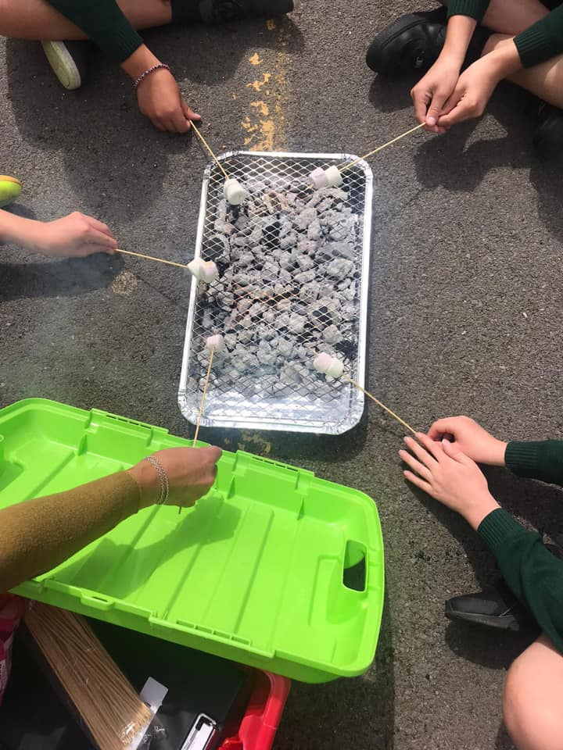
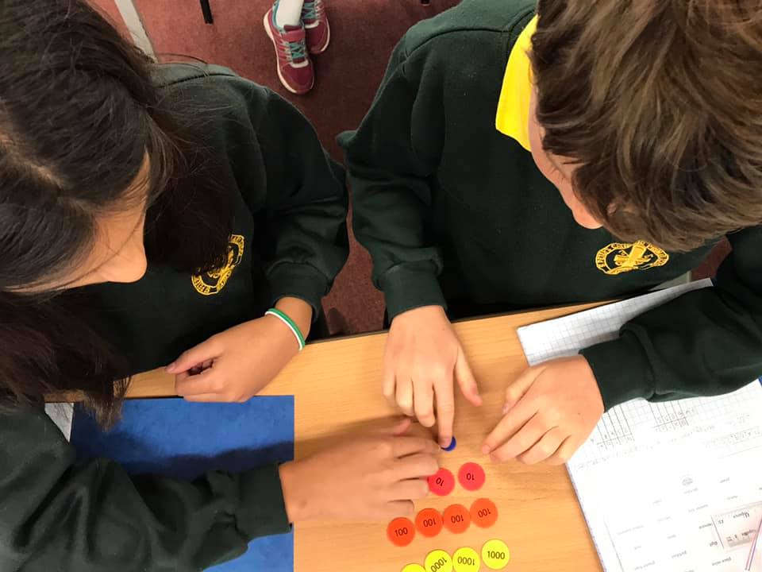
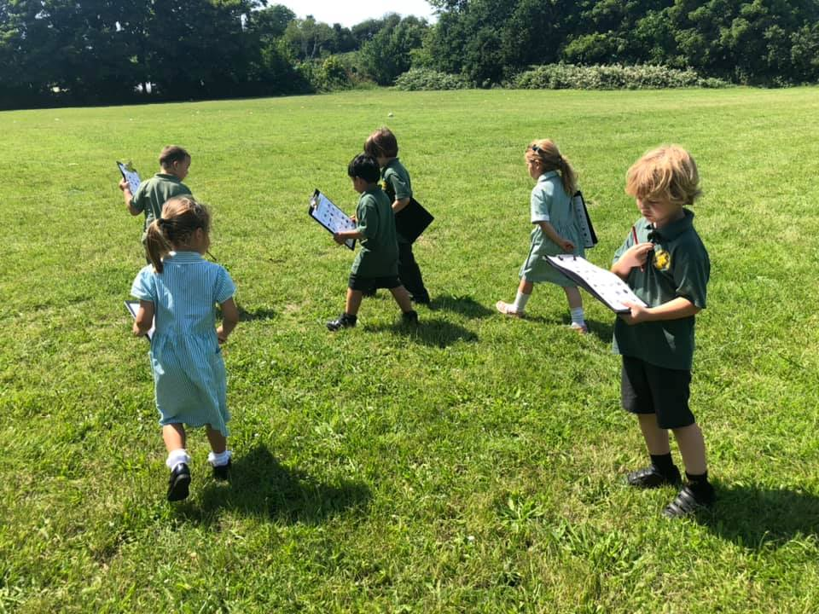
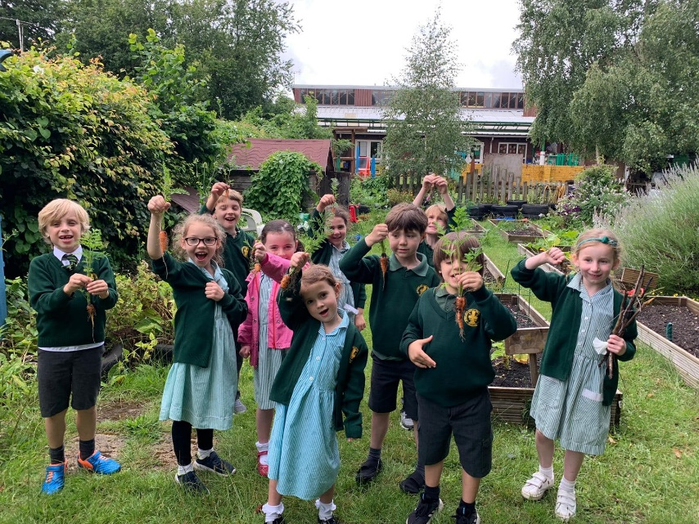
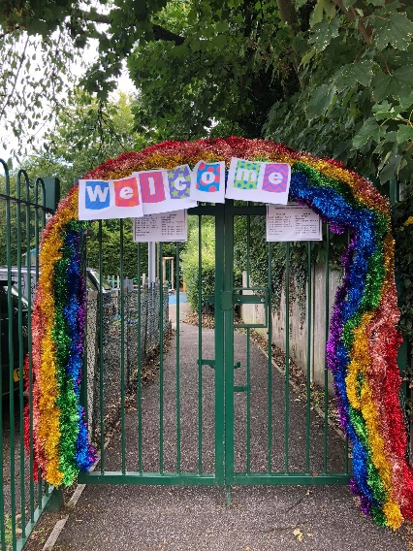
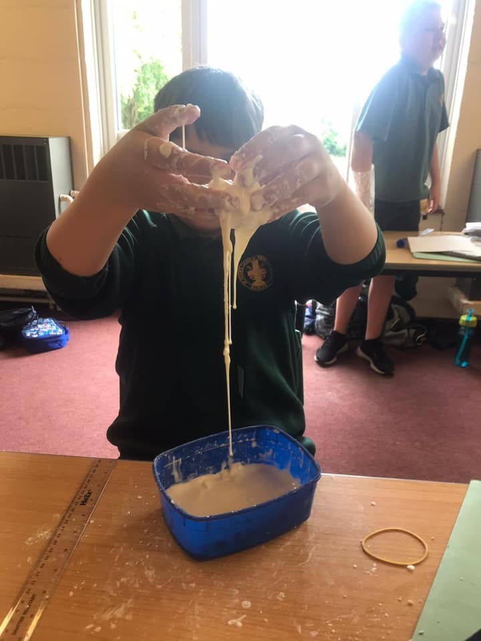
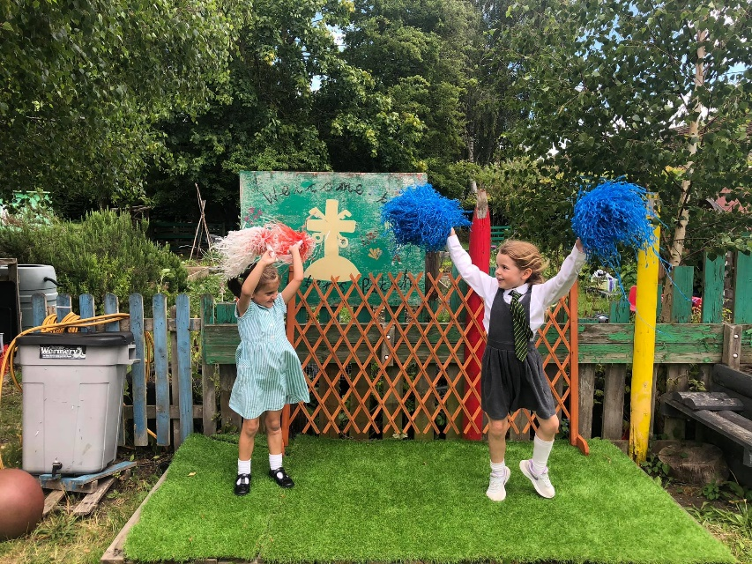
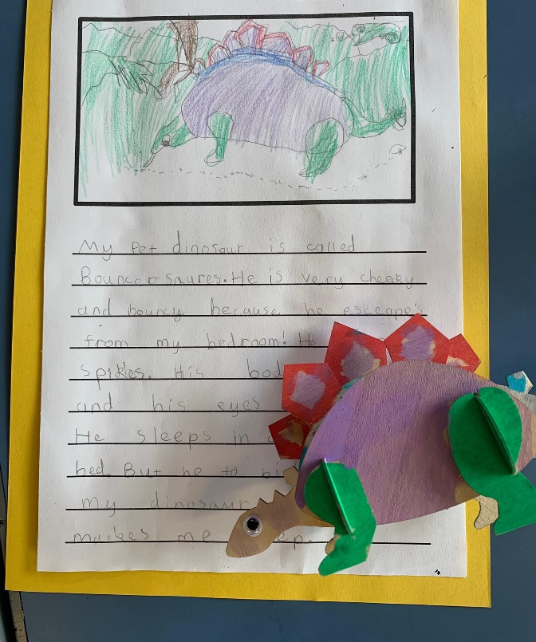
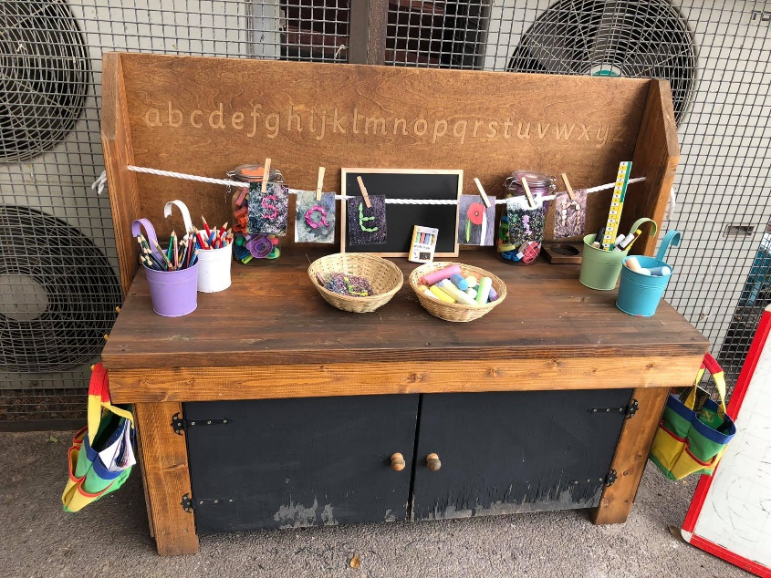
Spread the word…
Please spread the word about our wonderful and caring school to your friends and family.

