Slide 1
Reception Welcome Meeting
22nd September 2020

Slide 2
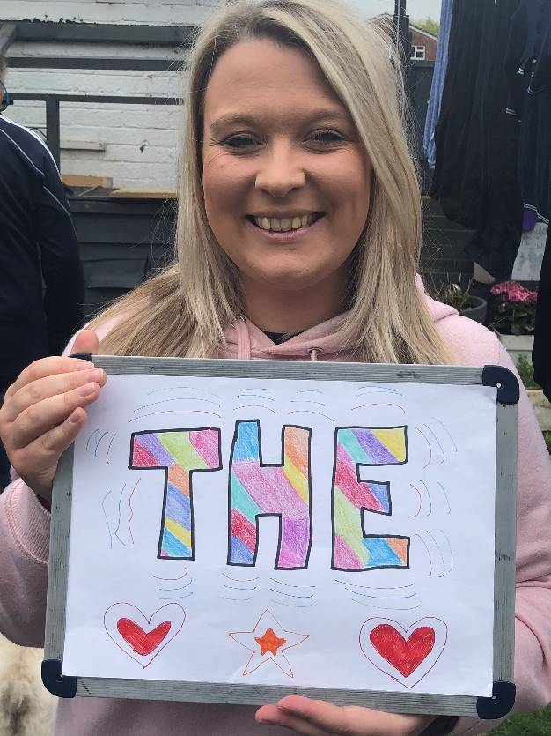
Meet the Team
Miss Hockley – class teacher. In everyday except Monday afternoons (planning and assessment time). There may be exceptions to this if I have time for Maths leadership.

Slide 3
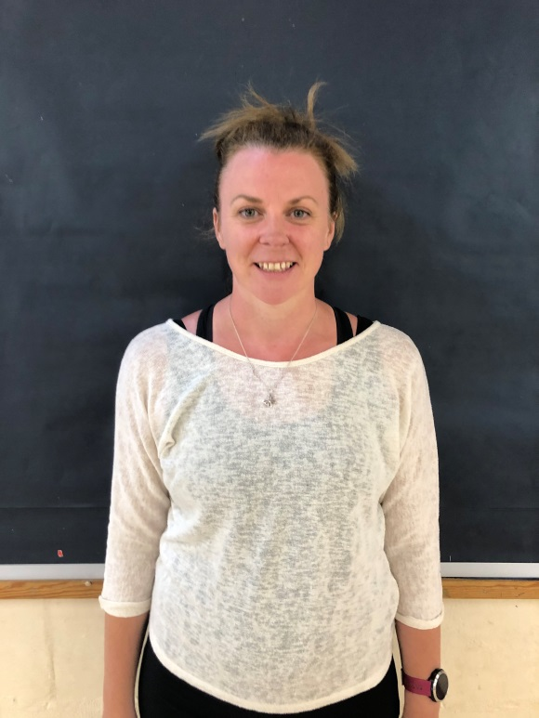
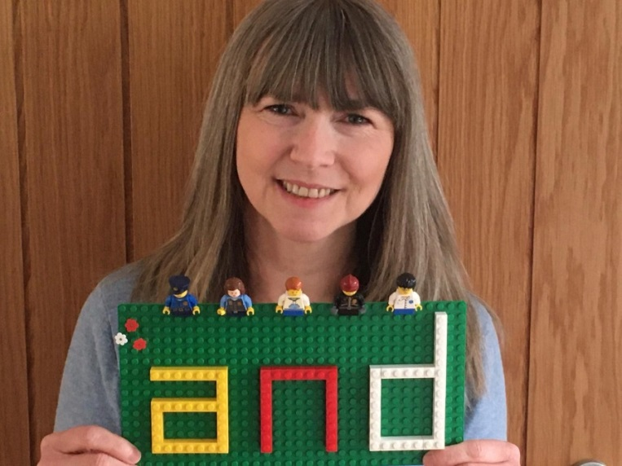
Meet the Team
Mrs Lanyon Mrs Taylor
Teaching Assistant Teaching Assistant
Mon – Thurs Fridays

Slide 4
Meet the Team
Mrs Bowler – PPA cover on Monday afternoons.

Slide 5
EYFS Curriculum
In EYFS we follow The EYFS Profile Curriculum. There are 7 areas of learning, 3 prime and 4 specific.
Children will be assessed as to whether they have met the 17 early learning goals in the summer term.
Children also have to demonstrate the ‘characteristics of effective learning’ during their free choice time.
Each surround the ‘Unique Child’ and integrate with each other.
Each week children will have set phonics, literacy, maths, RE, PE and computing times.
All will be based around the current topic.
Children are observed choosing and this is recorded and put in their learning journals.

Slide 6
EYFS Curriculum
Topic map will be provided each term with a summary of what we will be learning about.
Current topic is ‘Ourselves’, next topic is ‘Celebrations’.
Small inputs (around 15/20 minutes) and then ‘choosing’. Adult led activities will happen at the same time as choosing.
Children will get free flow between inside and outside when there is adult supervision in place.

Slide 7
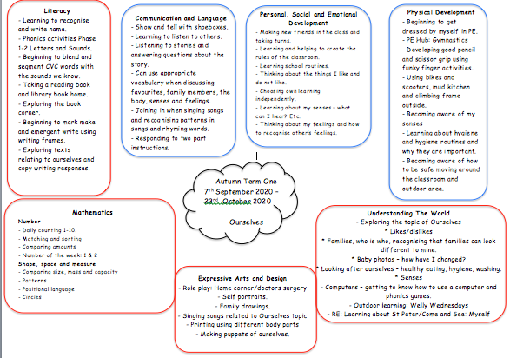

Slide 8
Phonics
Phonics is learning the sounds of the words.
Children will develop their phonemic awareness by learning to hear, identify and manipulate sounds. This will then help them with their reading and writing.

Slide 9
Phonics Key Words
Phoneme: smallest unit of sound in a word.
Grapheme: the sound written down.
Diagraph: when two letters make a phoneme/sounds.
Split diagraph: when a diagraph is in a word, but are not together, for example cake.
Blend: putting sounds together to make words, for example c-a-t
Segment: splitting sounds in a word – this can help with spelling.
CVC words: consonant vowel consonant words. Simple words that the children will begin to read. For example, s-a-t.

Slide 10
How do we teach phonics?
Phonics is taught daily.
Children will learn around 3 new sounds a week.
Children are encouraged to use phonics all the time by the adults around them modelling.
We follow Letters and Sounds programme. Children will learn Phase 2 – 4 in Reception and Phase 5 in year one, moving onto spelling patterns in year 2.
At the end of year one children will have a phonics check.

Slide 11
Phonics Tricky words
Also known as high frequency words or ‘jelly fish words’.
They are words that children won’t be able to blend and segment to read.
Children should be able to recognise and read these words from memory.
Words will go home to practice.

Slide 12
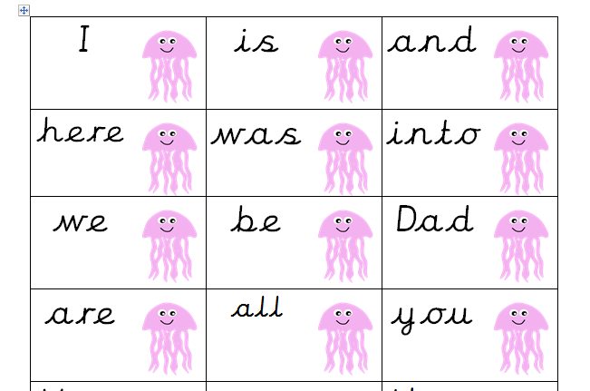

Slide 13
Helping At Home
Reading books and phonics flash cards/tricky words.
Sounding out simple words as you are saying them.
Pointing out words that begin with/have the new sound in them (these will be on the bottom of the weekly news).
Using sounds rather than alphabet.

Slide 14
Helping At Home
Phonics play website
Youtube: Jolly Phonics, Mr Brock phonics, letters and sounds videos.
Alphablocks
Teach Your Monster to Read website

Slide 15
Reading
Children will be provided with a reading folder, reading record (this will stay in school for now) and phonics cards.
Each week they will take home a new library book (on Fridays) and a new reading book (any day of the week).
Your child will be heard read at school once a week until Spring term when it will change to 3 times a week (books changed Monday, Wednesday and Friday).
Children will move up each reading level when I feel they are ready to.
Please ensure that reading folders come to school everyday, and are placed in the green box which will be on the table near the pegs.
Please bring back library books on a Friday
Should you ever have any questions about supporting your child’s reading or phonics please let me know.

Slide 16
Maths
We follow Maths Mastery curriculum at St. Peter’s (linked to Singapore maths).
This may then seem like number work is slower and more basic but the children are going to spend more time getting to know the numbers individually which links to mastery.

Slide 17
Growth Mindset
St Peters is a ‘Growth Mindset School’.
Growth mindset focuses on ‘keeping on trying’ ‘I can’t do it yet’ ‘I can be better then my best’.
Children will be taught Growth Mindset lessons and the mindset is encouraged at all times.

Slide 18
Proud Of You Notes
Parents are to fill out when their child does something amazing or achieves something they have not done before.
Hand in to us and we can put them in learning journals and they can contribute to assessment.
Please ask if you ever need more.

Slide 19
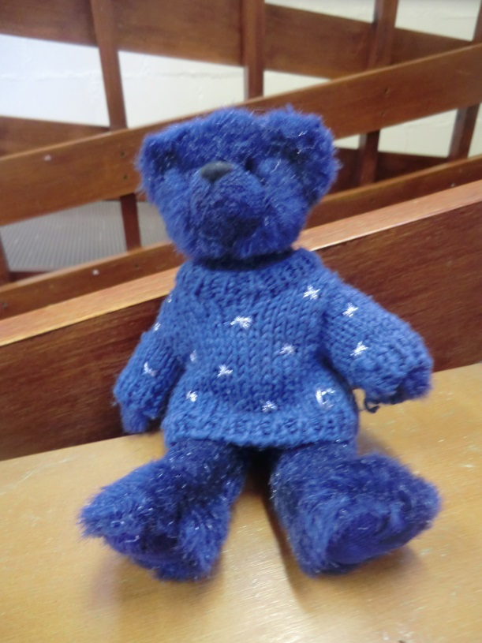
Sally’s Weekends

Slide 20
Prayer Bag
Sent home on a rotation on a Friday and needs to be returned by Wednesday.
There is a contents page inside with all the things in the bag.
A thing to share as a family, write a prayer (shared in class), learn about the class saint.

Slide 21
COVID-19
The main symptoms of coronavirus (COVID-19) are:
a high temperature – this means you feel hot to touch on your chest or back (you do not need to measure your temperature)
a new, continuous cough – this means coughing a lot for more than an hour, or 3 or more coughing episodes in 24 hours (if you usually have a cough, it may be worse than usual)
a loss or change to your sense of smell or taste – this means you've noticed you cannot smell or taste anything, or things smell or taste different to normal
Do not send your child into school with any of the above and get them tested. Inform the school immediately test results received.
If in doubt don’t send them in
If there is a confirmed case Thames Valley Authority will take the lead

Slide 22
Punctuality and Attendance
Staggered start
Please don’t come before your child’s class start time (9.10)
If you have children in more than 1 year group there is a waiting zone in the playground
If you are early please wait in your car if you have driven
If have to wait stand in a line by the hedge (socially distanced) so other parents can walk safely past.
When you have dropped your child please exit Prospect Road via the opposite side of the road as quickly as possible to keep everybody socially distanced.
Please keep to the one way system in school
Staggered finish
Our finish time is 2.45 at the quiet room door.
If you have an older child, come for their time.

Slide 23
Punctuality and Attendance
If you are late please enter through the school office.
If there is consistent lateness a letter will be sent and a meeting may be arranged.
Holidays are not authorised. (Absence forms can be collected from the office).

Slide 24
Punctuality and Attendance
Please inform the office of absence.
You will receive a call at 9.30 if we have any absences we are not aware of.
No child should return to school until 48hours after vomiting
Your child should not be in school with an upset stomach for 48 hours.

Slide 25
Snack/lunch times
Snacks should be ‘snacks’ and should be fruit or vegetables. We will ask children to take any snacks back home if they are not considered a healthy option.
Please ensure you are ordering hot dinners – please let me know if you are having any problems with this.
Healthy lunches – no nuts/seeds or kiwi fruit.
Birthdays: we are now asking parents not to bring in sweets/cakes for birthdays. We will celebrate birthdays in class.

Slide 26
Behaviour
Our school behaviour policy revolves around our school rules, ‘faces’ and reflection.
Children have 3 chances before being put in reflection (unless it is any form of hurt/bullying).
Reflection means that children will miss their lunch play. Children will eat their lunch in reflection.
Parents are sent a letter to inform them that their child has been in reflection.
If the child has been in reflection twice in one week, a conversation will happen with parents.
If issues are not resolved, a behaviour management plan will be written.

Slide 27
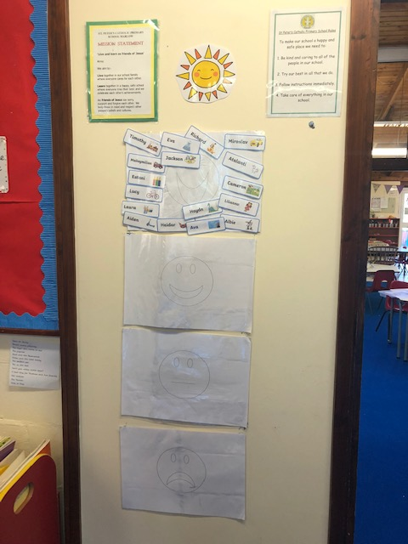

Slide 28
Positive Behaviour
We have a sun on the chart for amazing answers or behaviour.
Children will receive a ‘Miss Hockley’ sticker for any excellent work, completing the writing or maths challenge, or being a PE superstar.
Goal of the week.
Star of the Week and Good Disciple
Playground tokens
Please let us know if there is anything going on at home that may affect your child in school.

Slide 29
Reminders
Any medication should be up to date (eg. Inhalers). Can only be administered by trained staff.
Please bring money in an envelope.
A reminder to ensure all school uniform is neat and tidy and named. Long hair should be tied back. I will try my best to keep your child’s uniform as clean as possible but sometimes muddy clothes can mean great learning!
PE kits
Welly Wednesday’s every Wednesday unless specified.
Toys: please leave them at home ☺

Slide 30
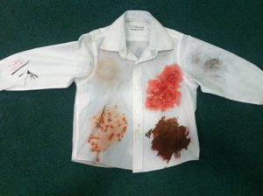

Slide 31
Contact
Please ensure that your contact information in the office is kept up to date.
We are still on the look out for a class rep.. any takers?

Slide 32
Donations
Tissues
Outgrown uniform
Sand/top soil
Junk modelling
Anything!

Slide 34
Spread the word!
Please spread the word about our wonderful and caring school to your friends and family!

Slide 35
Any questions?

